Slide 2
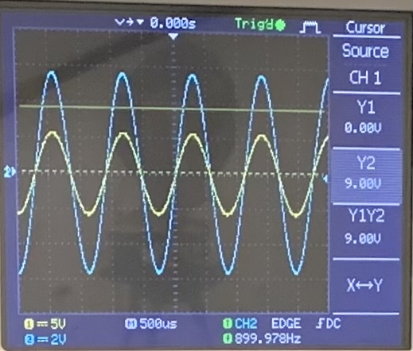
Problem Statement
The responses of a LRC circuit driven by an AC source can be changed by inserting either a non-magnetic metal rod or a ferromagnetic rod into the inductor coil. How can we obtain the magnetic and electric properties of the inserted rod from the circuit’s responses?

Slide 3
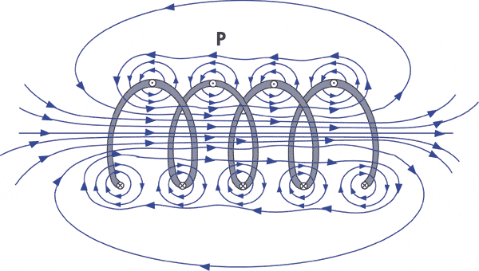
Basic physics
Inductor coil + AC current → changing magnetic field (magnetic induction)
Inserted rod interacts with this field
extra currents generate
magnetic field weakens/strengthens
Properties of the inductor change
Process:
measure the steady-state response of the circuit
circuit theory → acquire the properties of the inductor
electromagnetic theory → calculate the properties of the rod
coil1.gif (600×340) (nde-ed.org)
Notes:
electromagnetic phenomenons happen

Slide 4
I. LRC theory

Slide 5
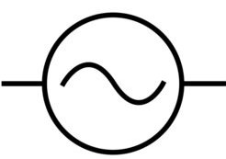
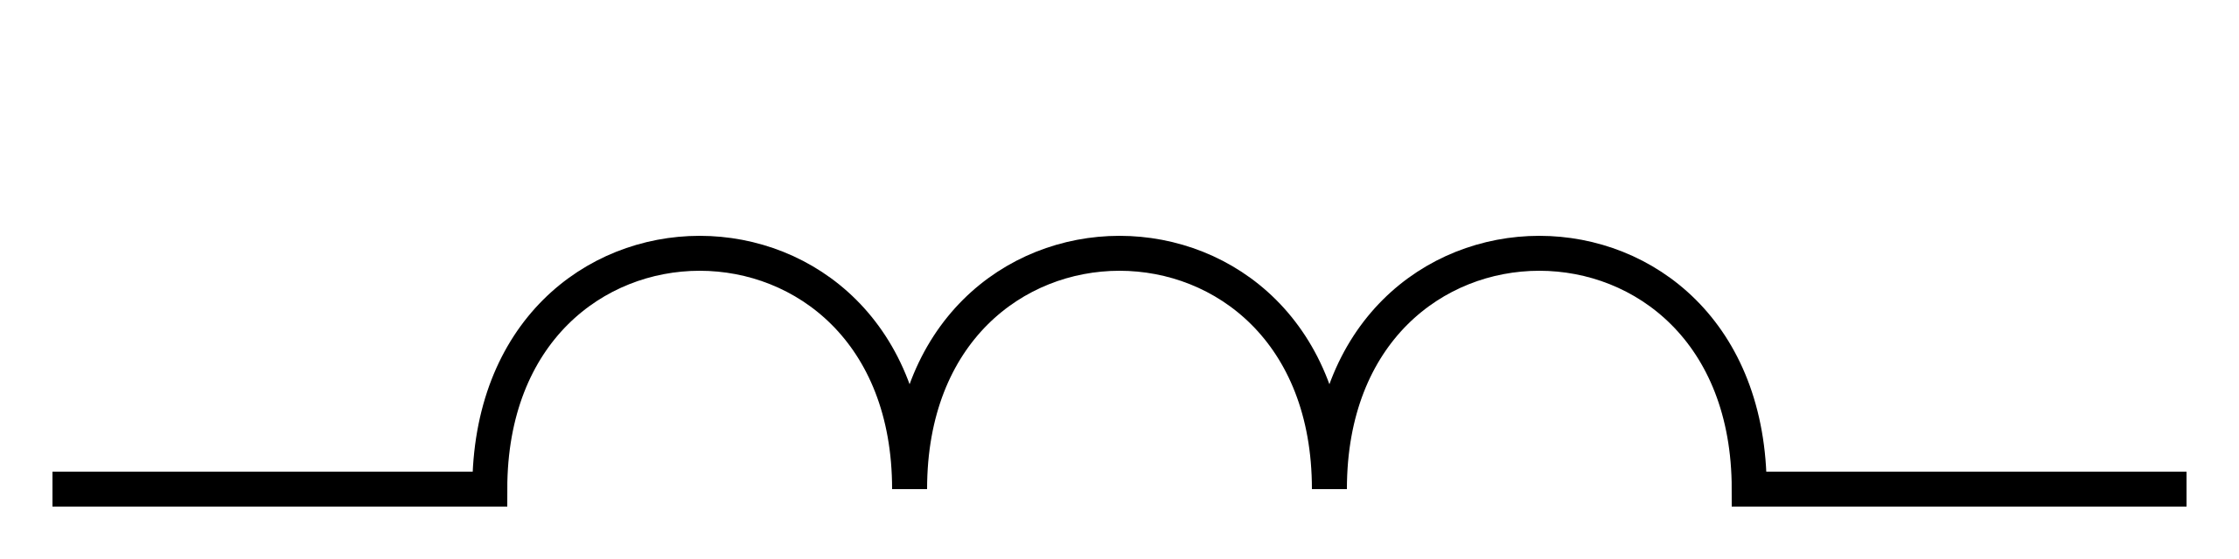
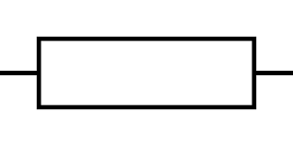
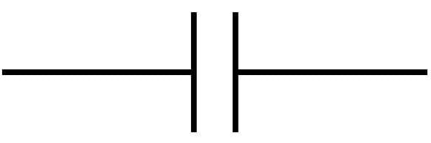

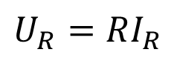
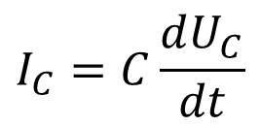
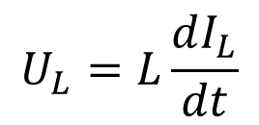
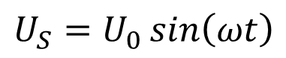
LRC circuit components
Driving AC voltage:
Inductor:
resists the change of current
voltage goes in front of current ($φ=90°$)
Resistor:
no phase difference between U and I
Capacitor:
resists the change of voltage
voltage lags behind current ($φ=−90°$)
$$U_{S}=U_{0}\sin\left(ωt\right)$$
$$U_{L}=L\frac{dI_{L}}{dt}$$
$$U_{R}=RI_{R}$$
$$I_{C}=C\frac{dU_{C}}{dt}$$
changes when inserting the rod
Notes:
reactance – resistance-like property

Slide 6
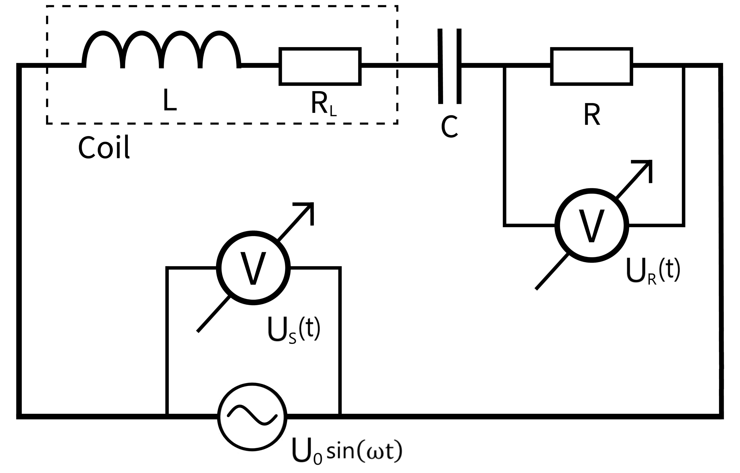
Circuit diagram

Slide 7
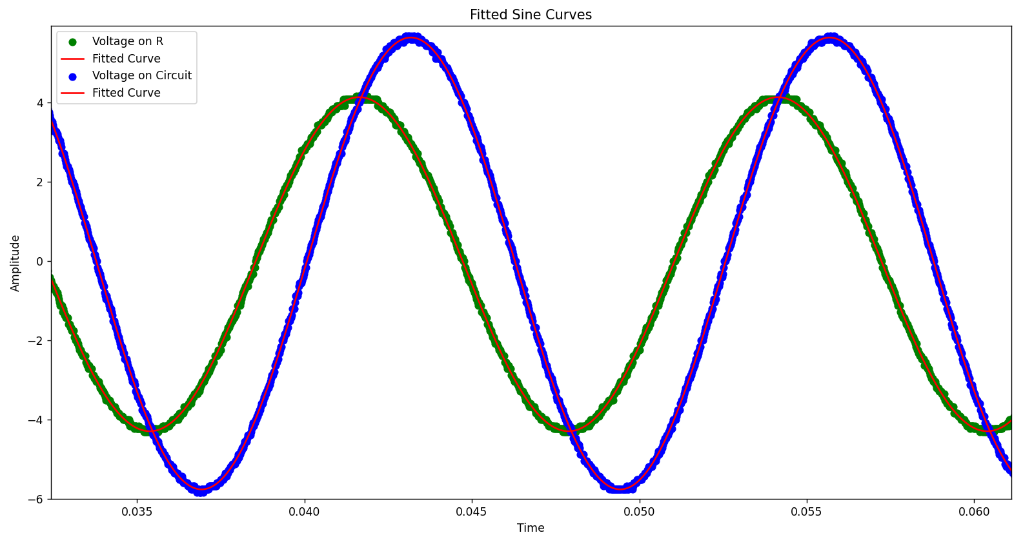



Circuit response – steady state
$$U_{S max}$$
$$φ$$
Voltage (V)
$$U_{R max}$$
Time (s)
Notes:
measured through a frequency spectrum

Slide 8
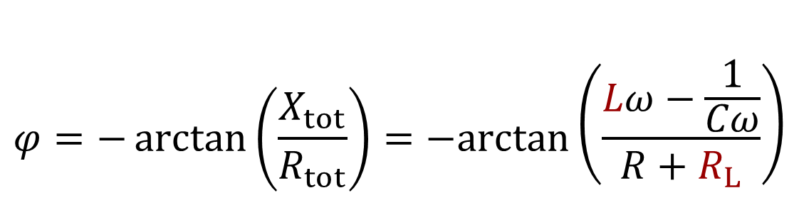
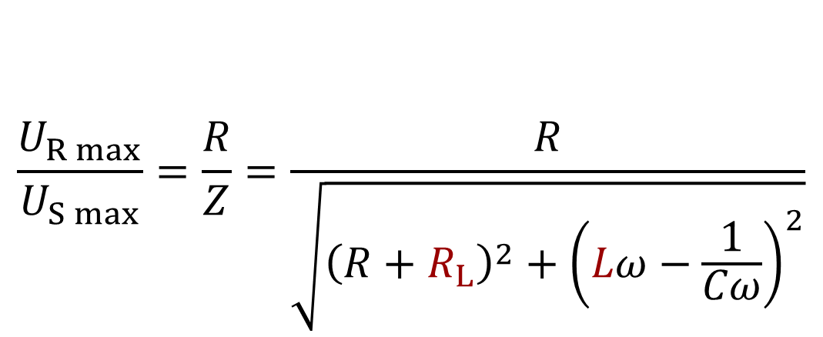
Basic equations
From Ohm’s law:
$$\frac{U_{R max}}{U_{S max}}=\frac{R}{Z}=\frac{R}{\sqrt{{\left(R+R_{L}\right)}^{2}+{\left(Lω−\frac{1}{Cω}\right)}^{2}}}$$
Z: impedance
Phase angle formula:
$$φ=−\arctan\left(\frac{X_{tot}}{R_{tot}}\right)=−arctan⁡\left(\frac{Lω−\frac{1}{Cω}}{R+R_{L}}\right)$$
X: reactance

Slide 9
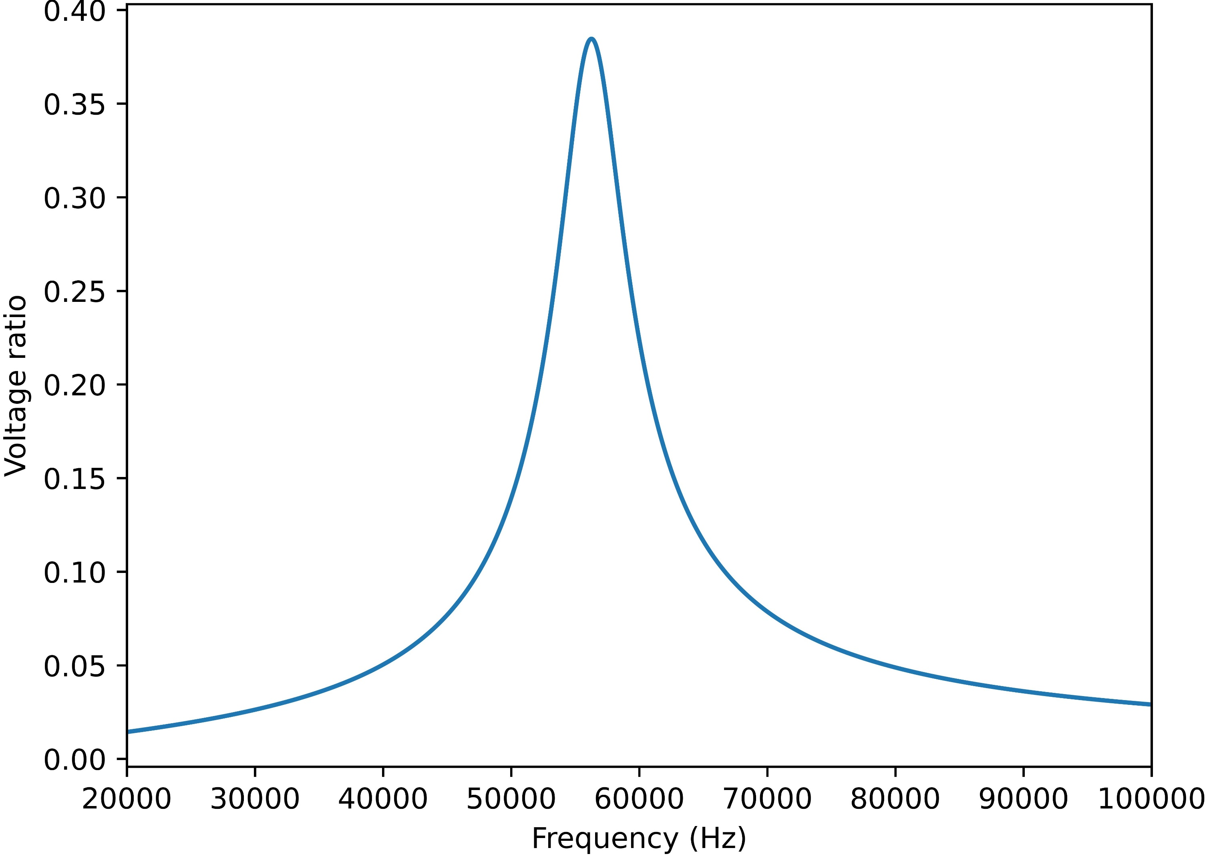

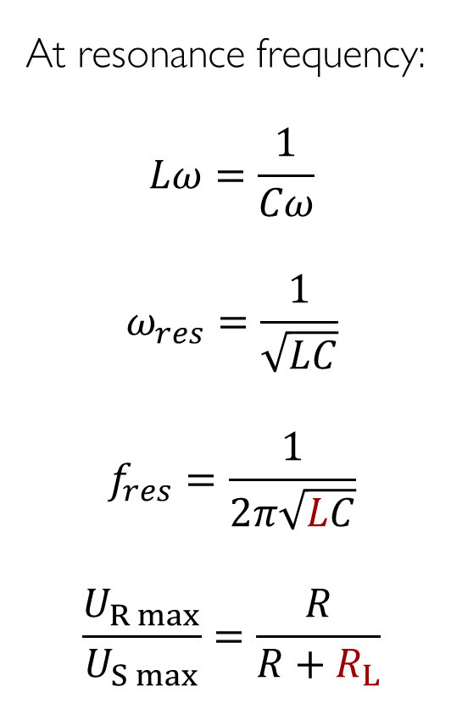


Voltage ratio graph
changing R_{L} or R
At resonance frequency:
$$Lω=\frac{1}{Cω}$$
$$ω_{res}=\frac{1}{\sqrt{LC}}$$
$$f_{res}=\frac{1}{2π\sqrt{LC}}$$
$$\frac{U_{R max}}{U_{S max}}=\frac{R}{R+R_{L}}$$
$$max\left(\frac{U_{R max}}{U_{S max}}\right)$$
$$\frac{R}{\sqrt{{\left(R+R_{L}\right)}^{2}+{\left(Lω−\frac{1}{Cω}\right)}^{2}}}$$
$$f_{res}$$
changing L or C
Notes:
plot legyen!

Slide 10
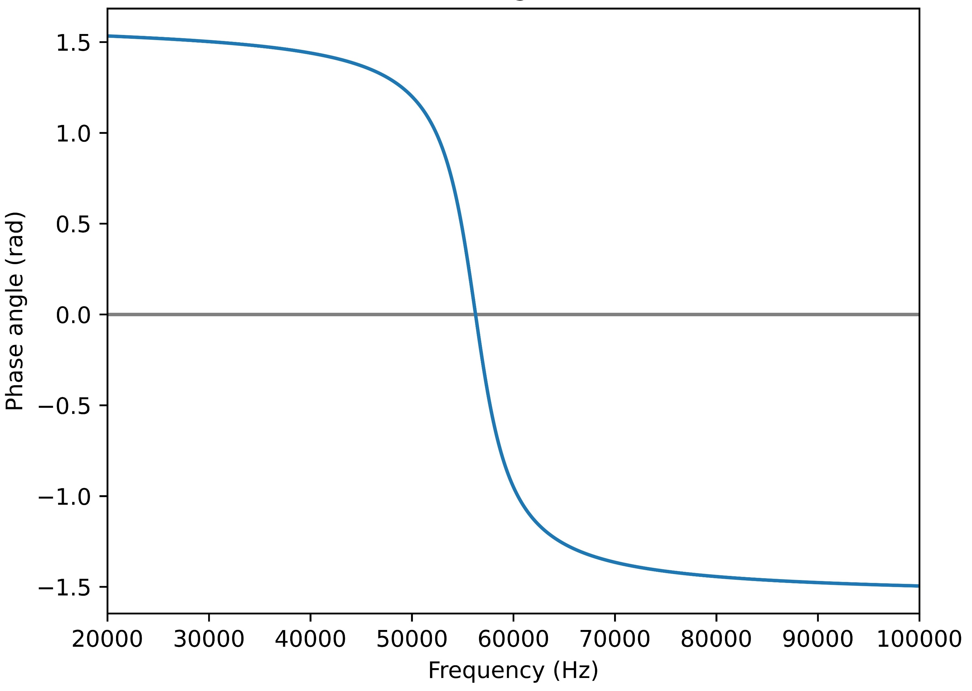


Phase angle graph
$$−arctan⁡\left(\frac{Lω−\frac{1}{Cω}}{R+R_{L}}\right)$$
$$f_{res}$$

Slide 11
II. Measurement setup

Slide 12
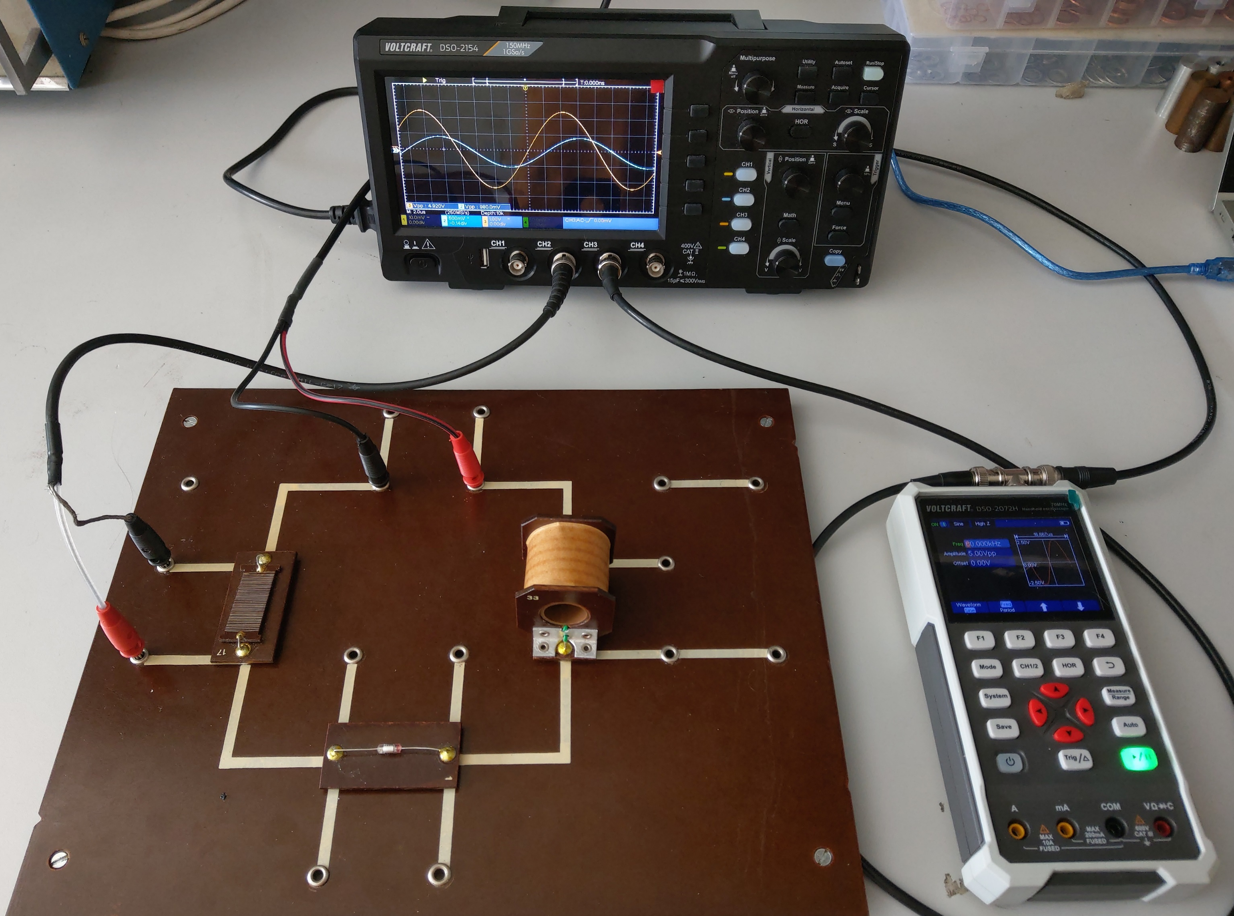
Setup – inductor
Inductor:
N = 1200
L₀ = 0.028 H
R₀ = 16.4 Ω
l = 5 cm
d = 1.9 cm
U₀ = 2.5V (sinusoidal)
Notes:
több kondi és elllenállás

Slide 13
Resistors and capacitors
C₁ = 272 pF
C₂ = 350 pF
C₃ = 4.71 nF
R₁ = 289 Ω
R₂ = 480 Ω
R₃ = 1041 Ω

Slide 14
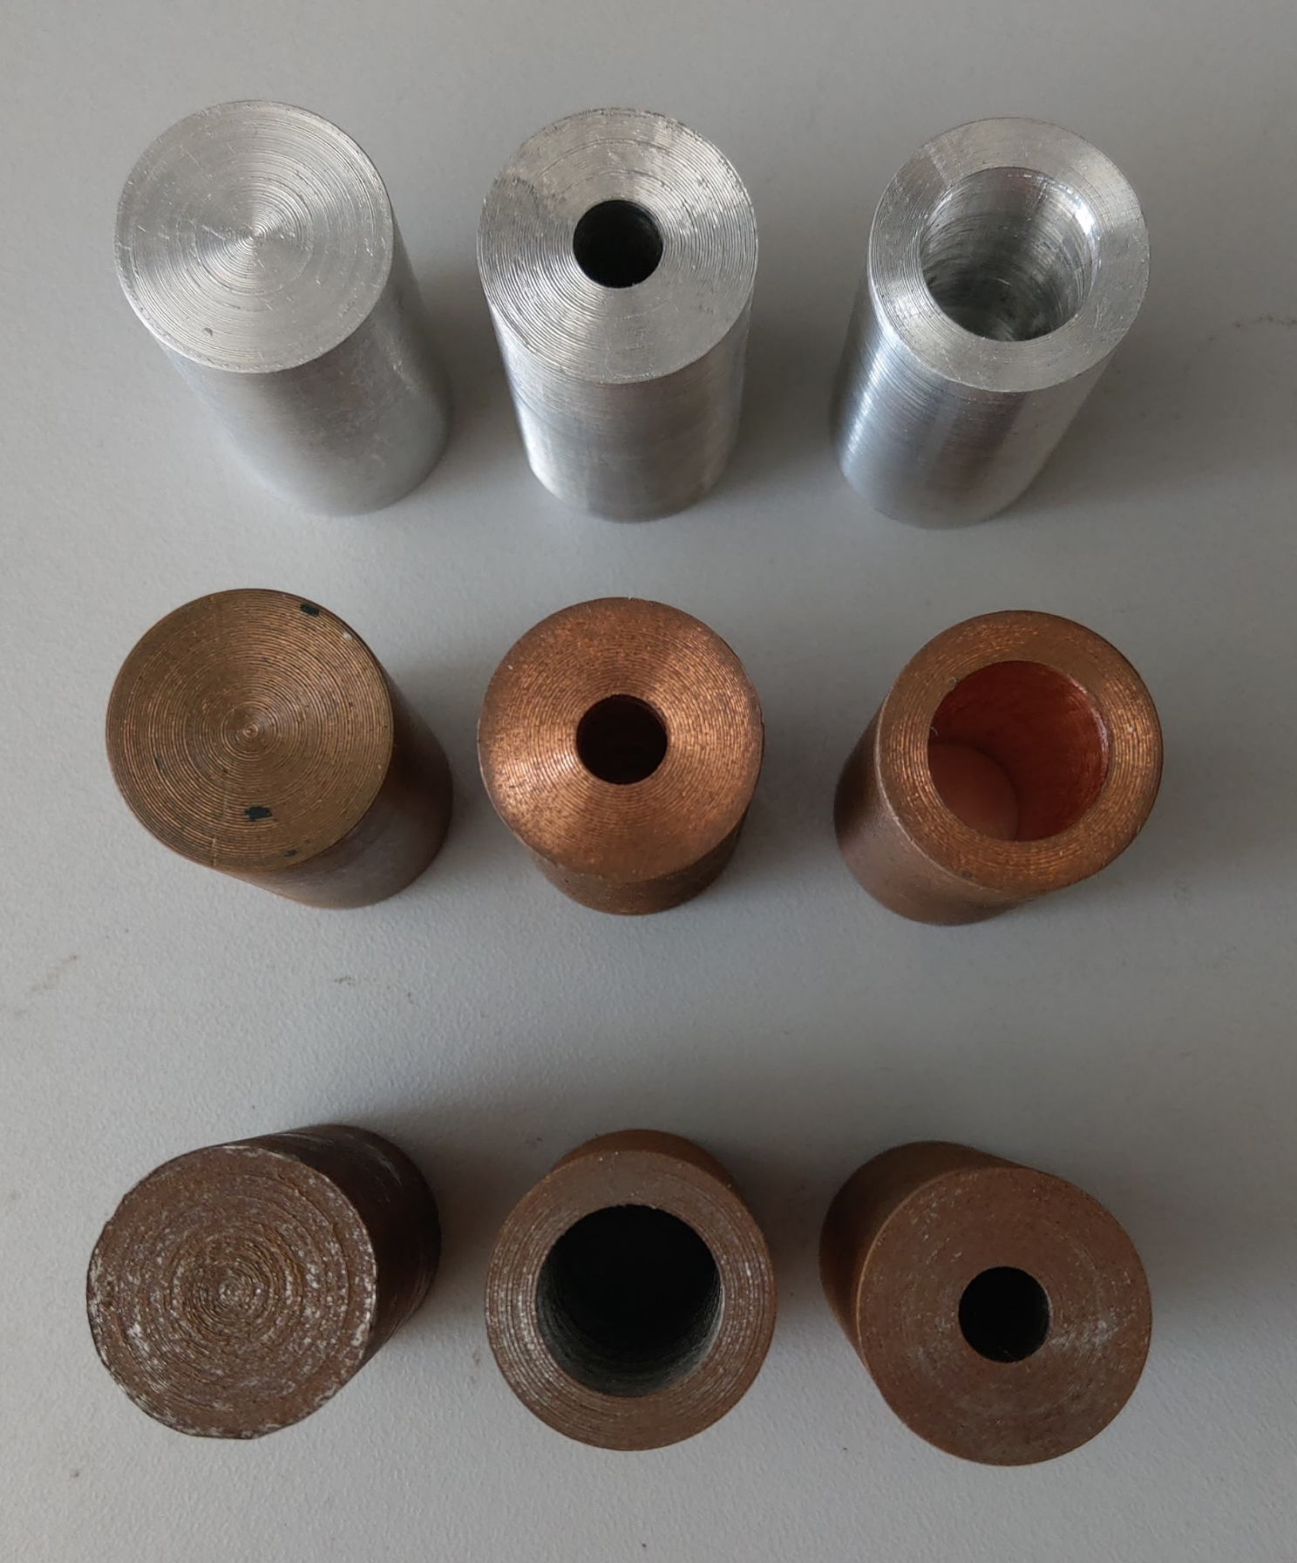
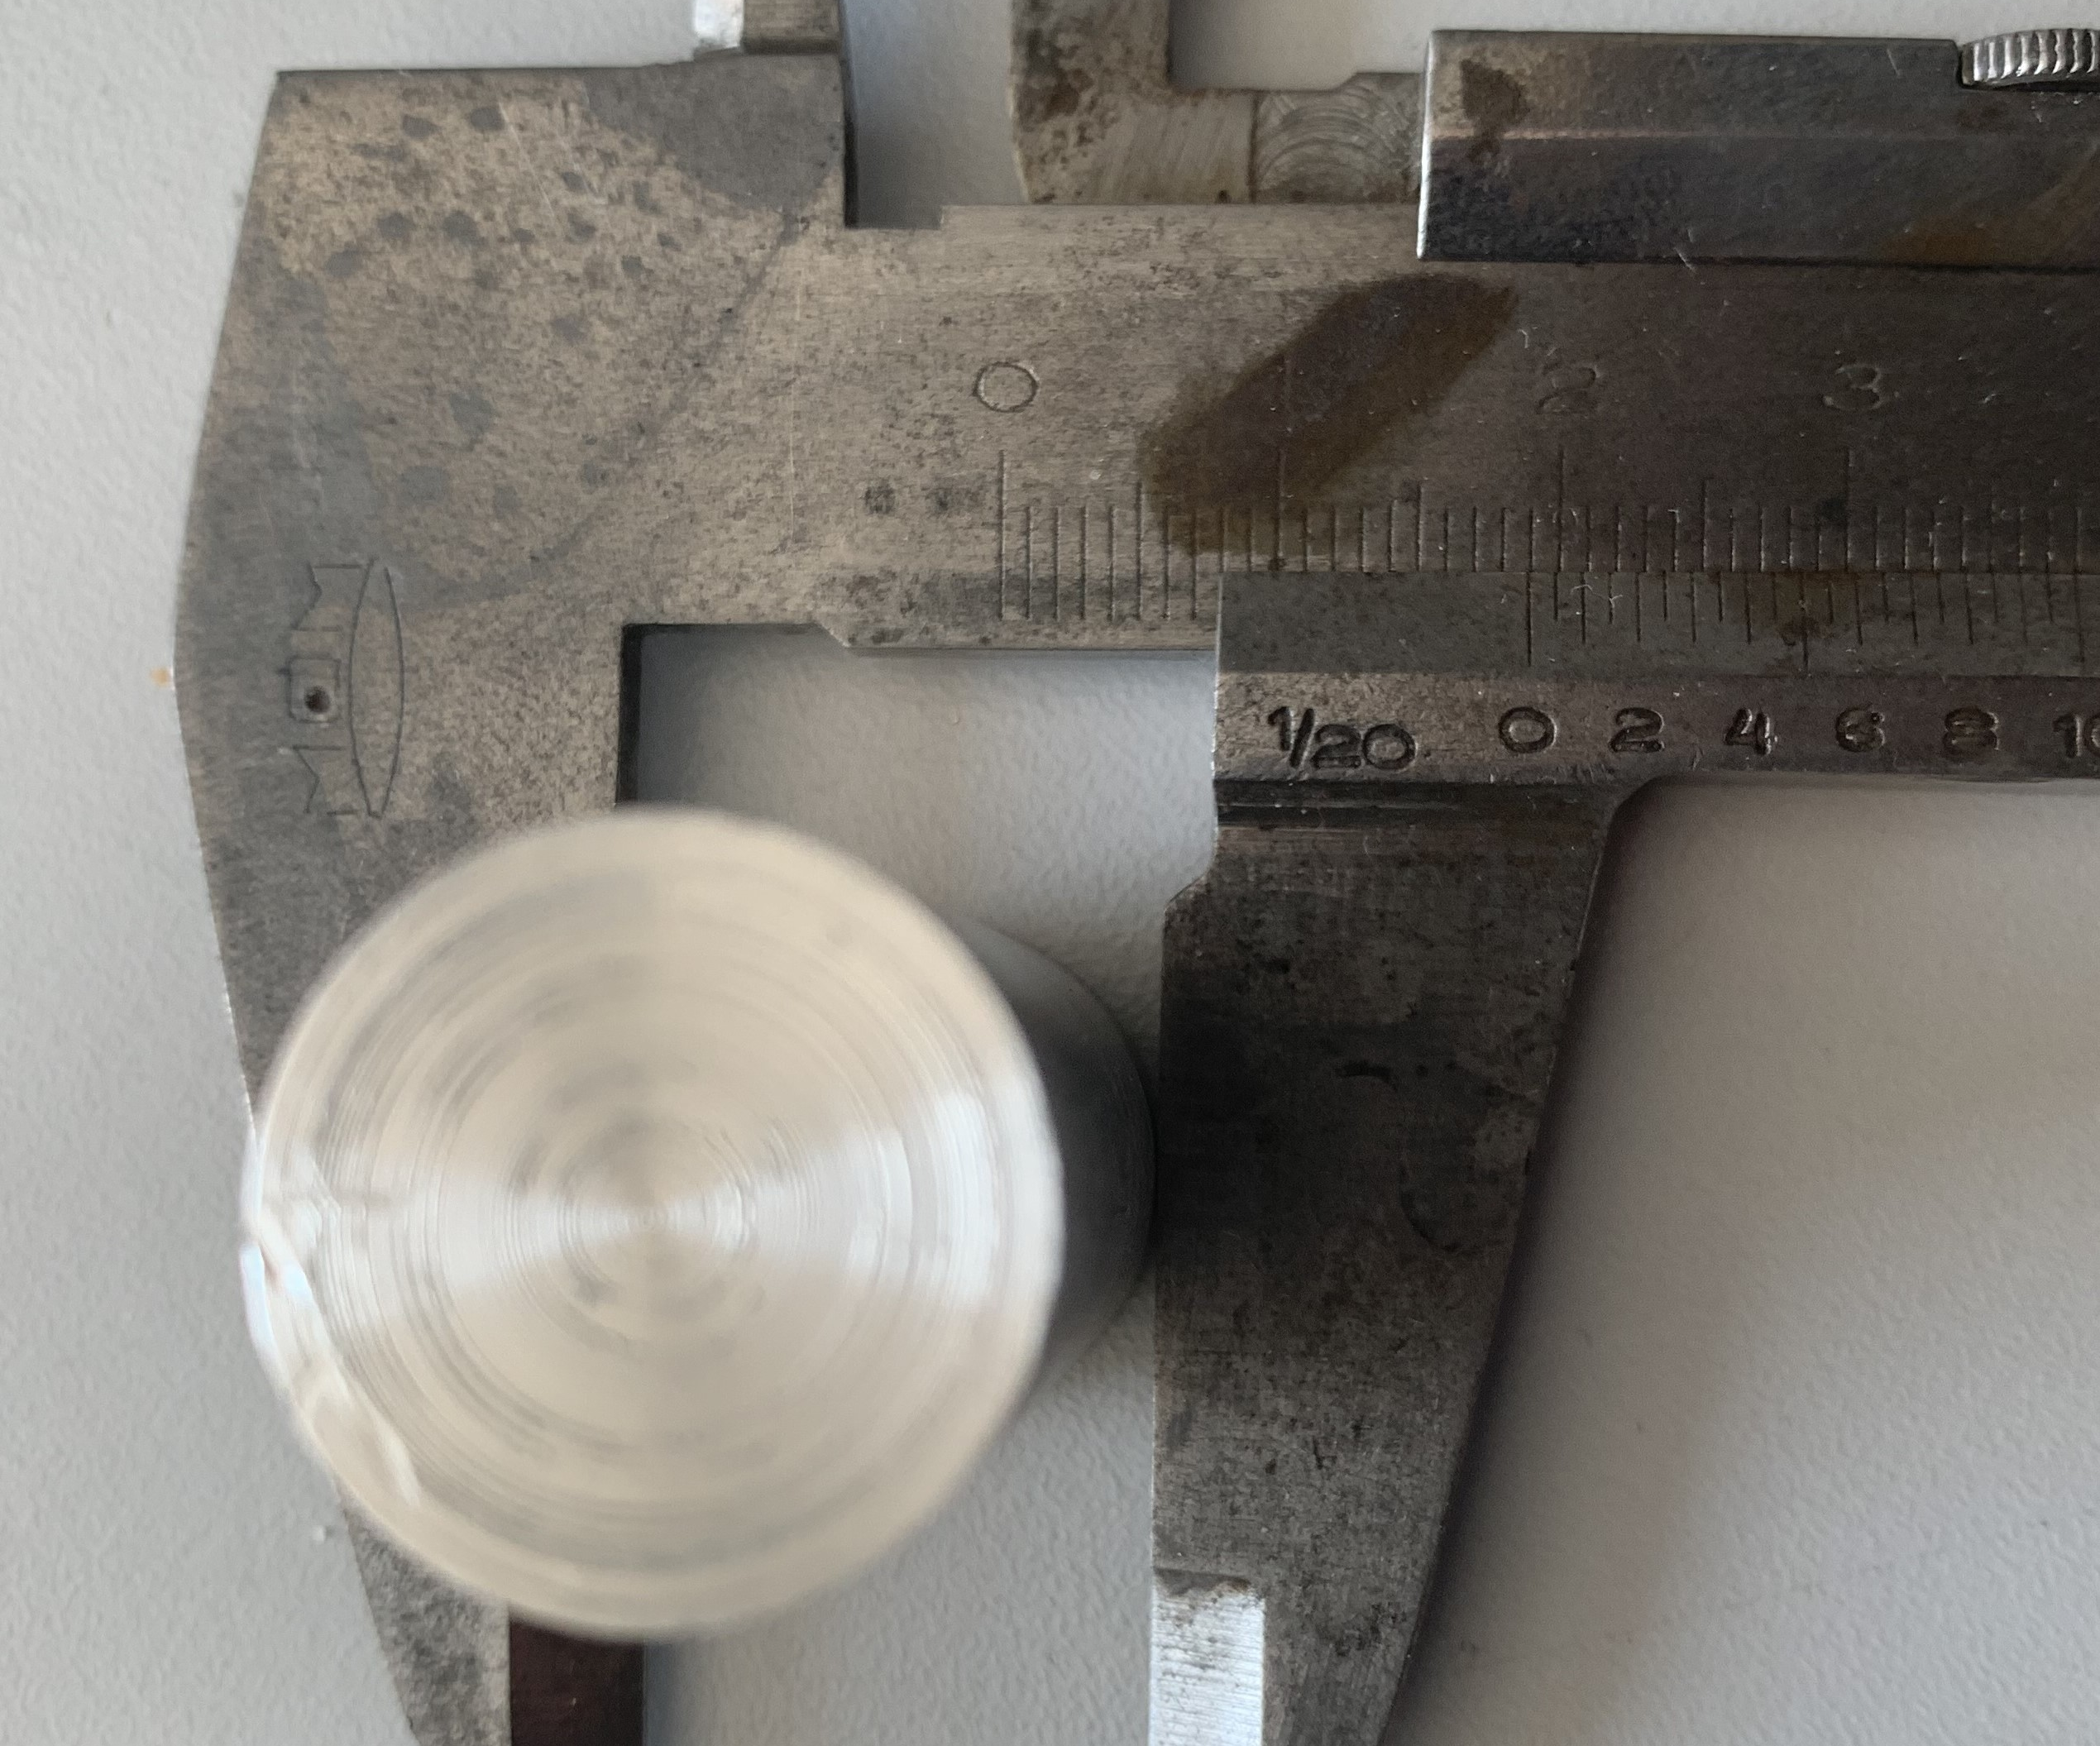
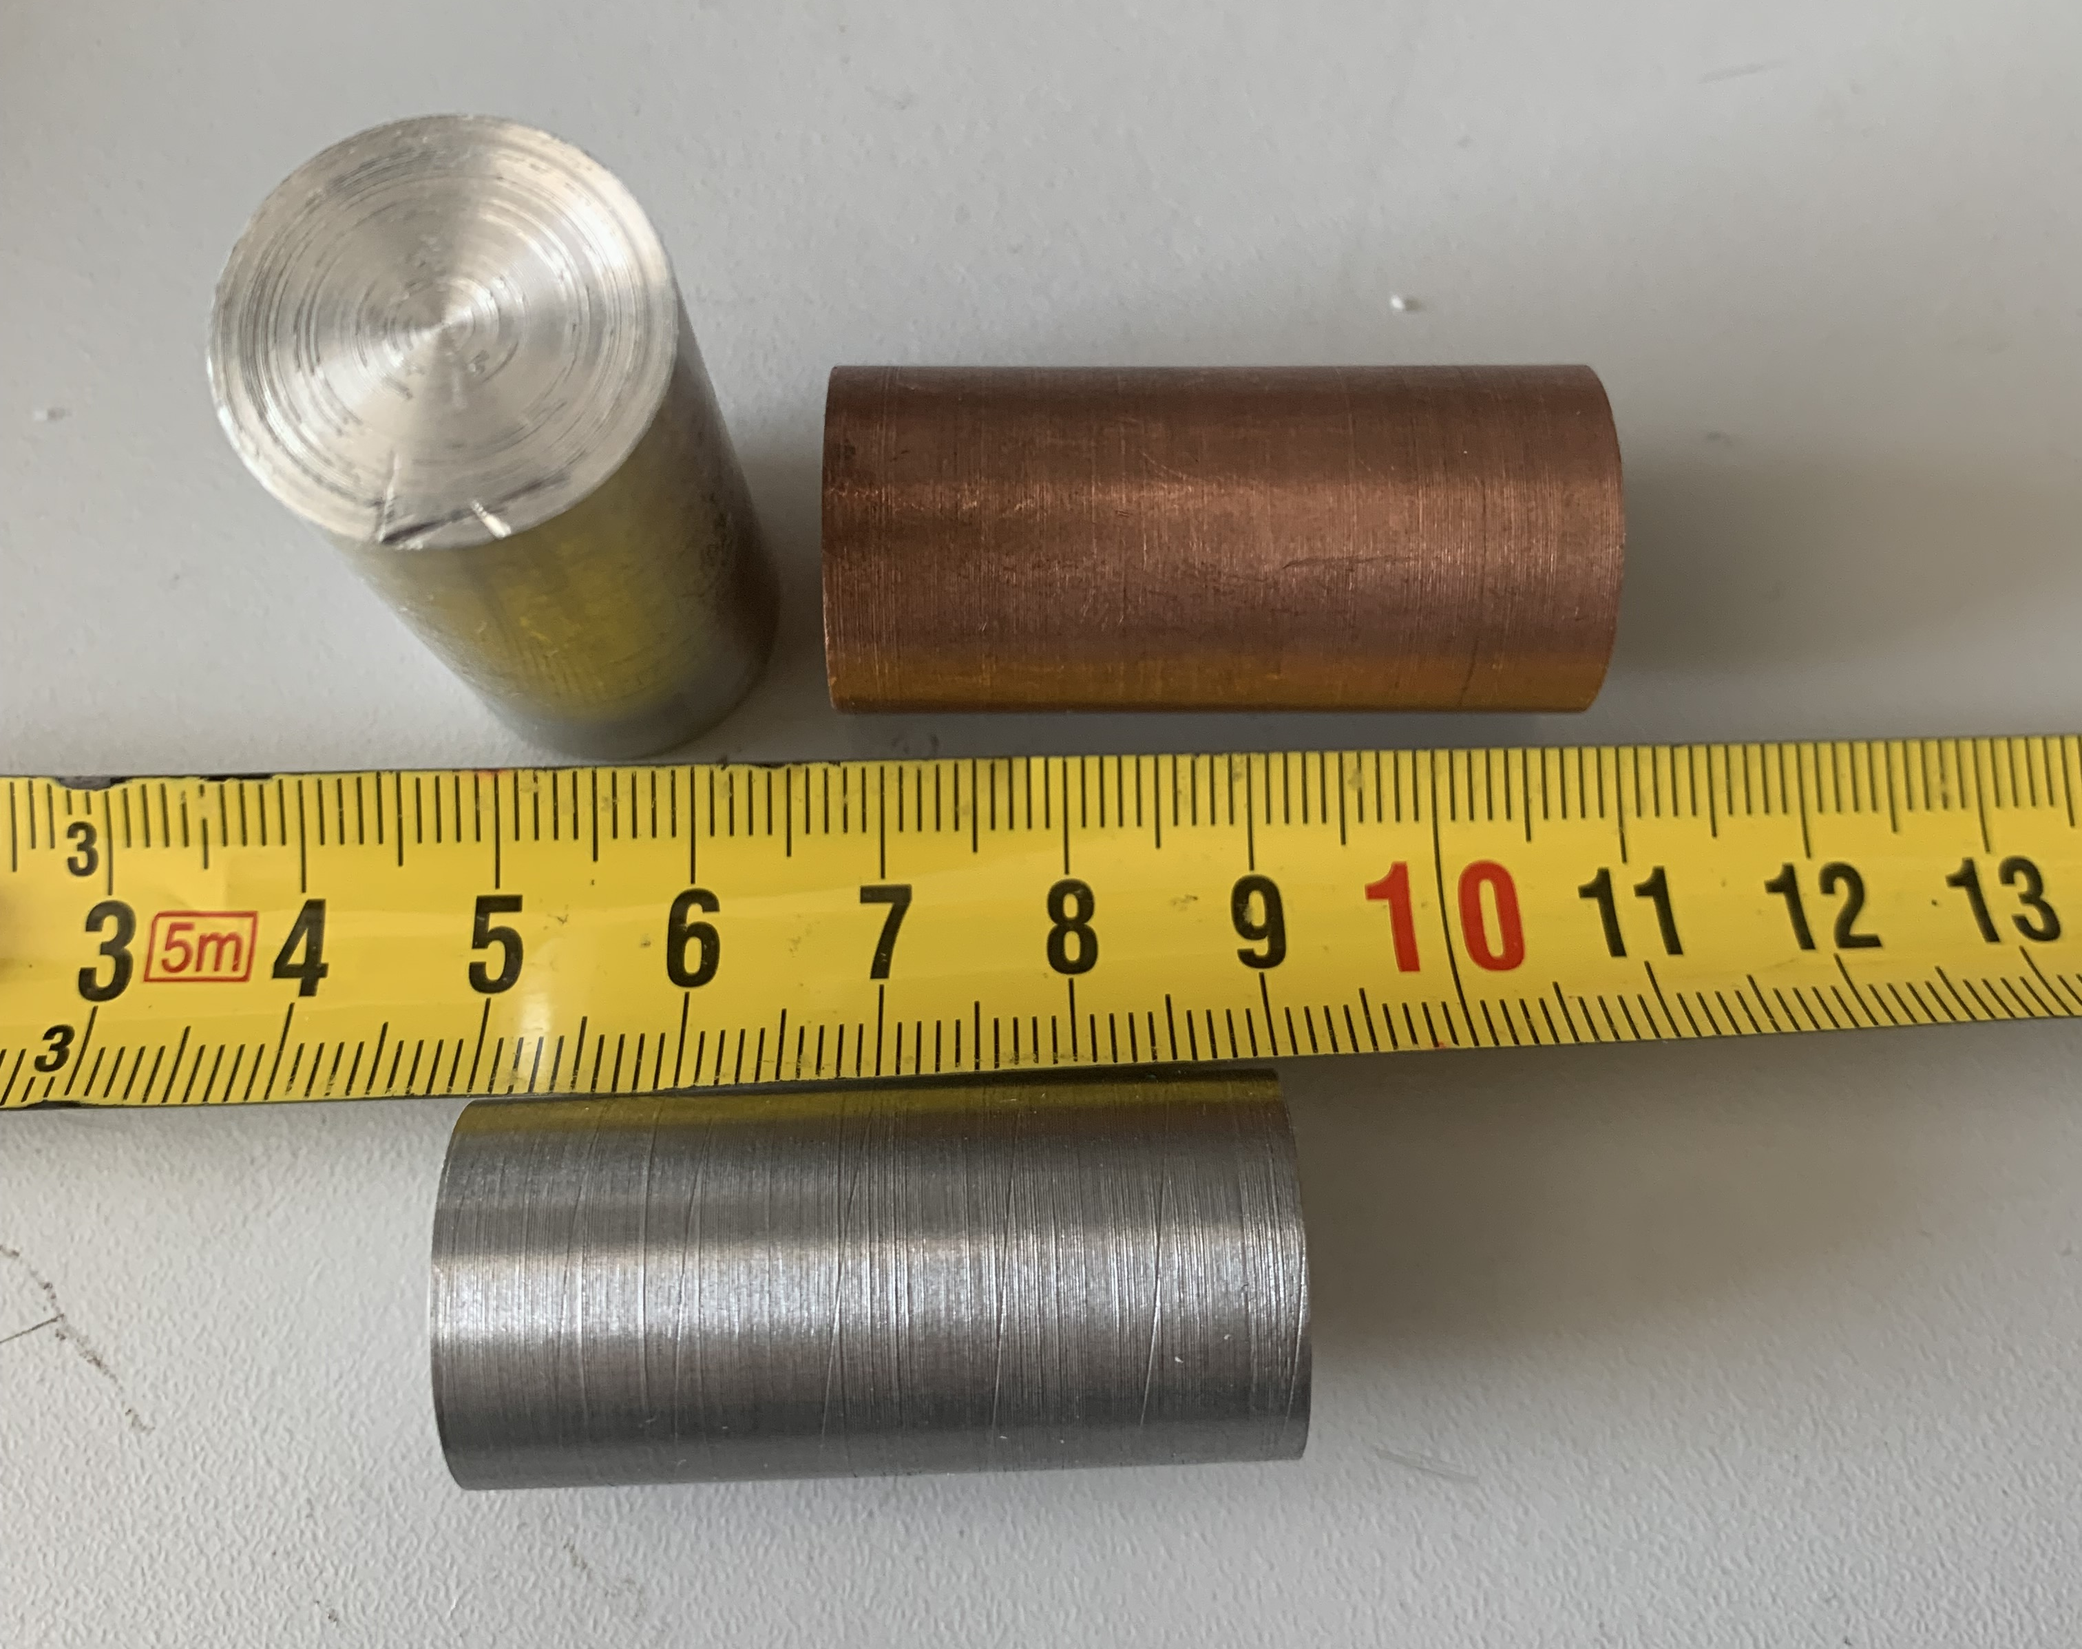
Rods
Rod materials:
Aluminium (Al)
Copper (Cu)
Iron (Fe)
Drilled holes
non-magnetic conductors
ferromagnetic

Slide 15
Instruments
XDG 3162 Function generator
DSO 4022 Oscilloscope

Slide 16
III. Results

Slide 17
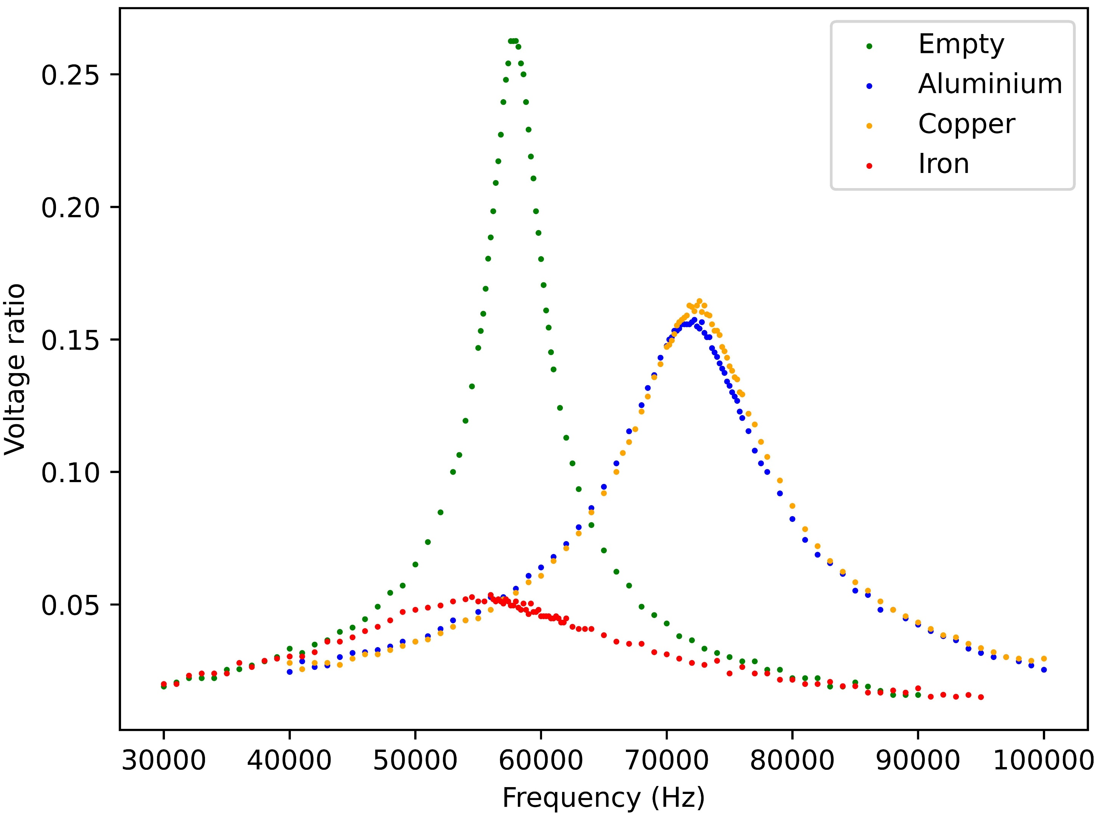
Voltage ratio for different materials

Slide 18
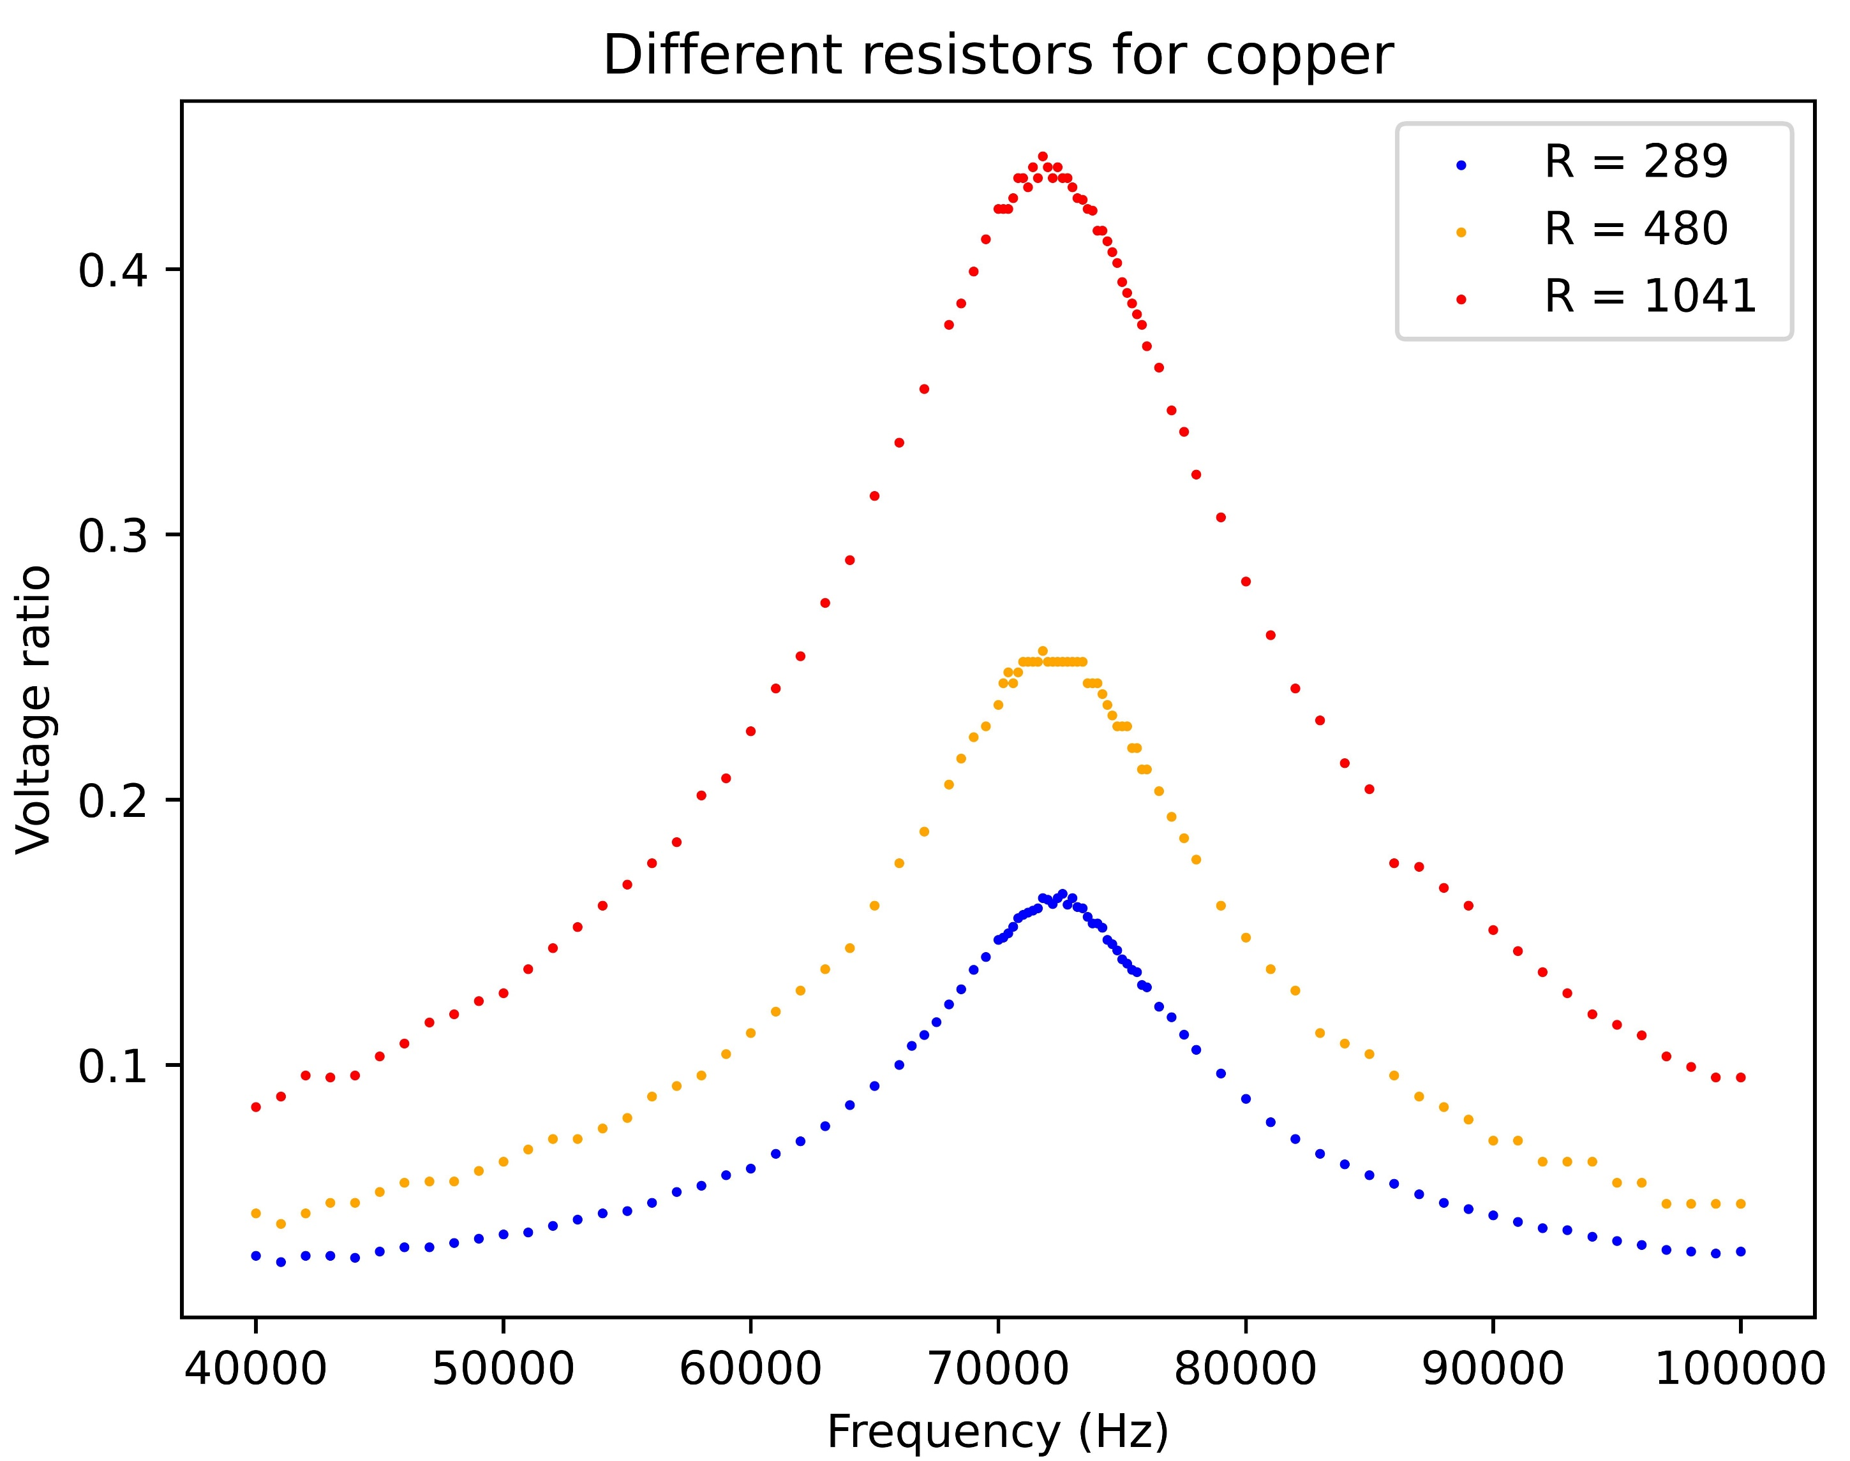
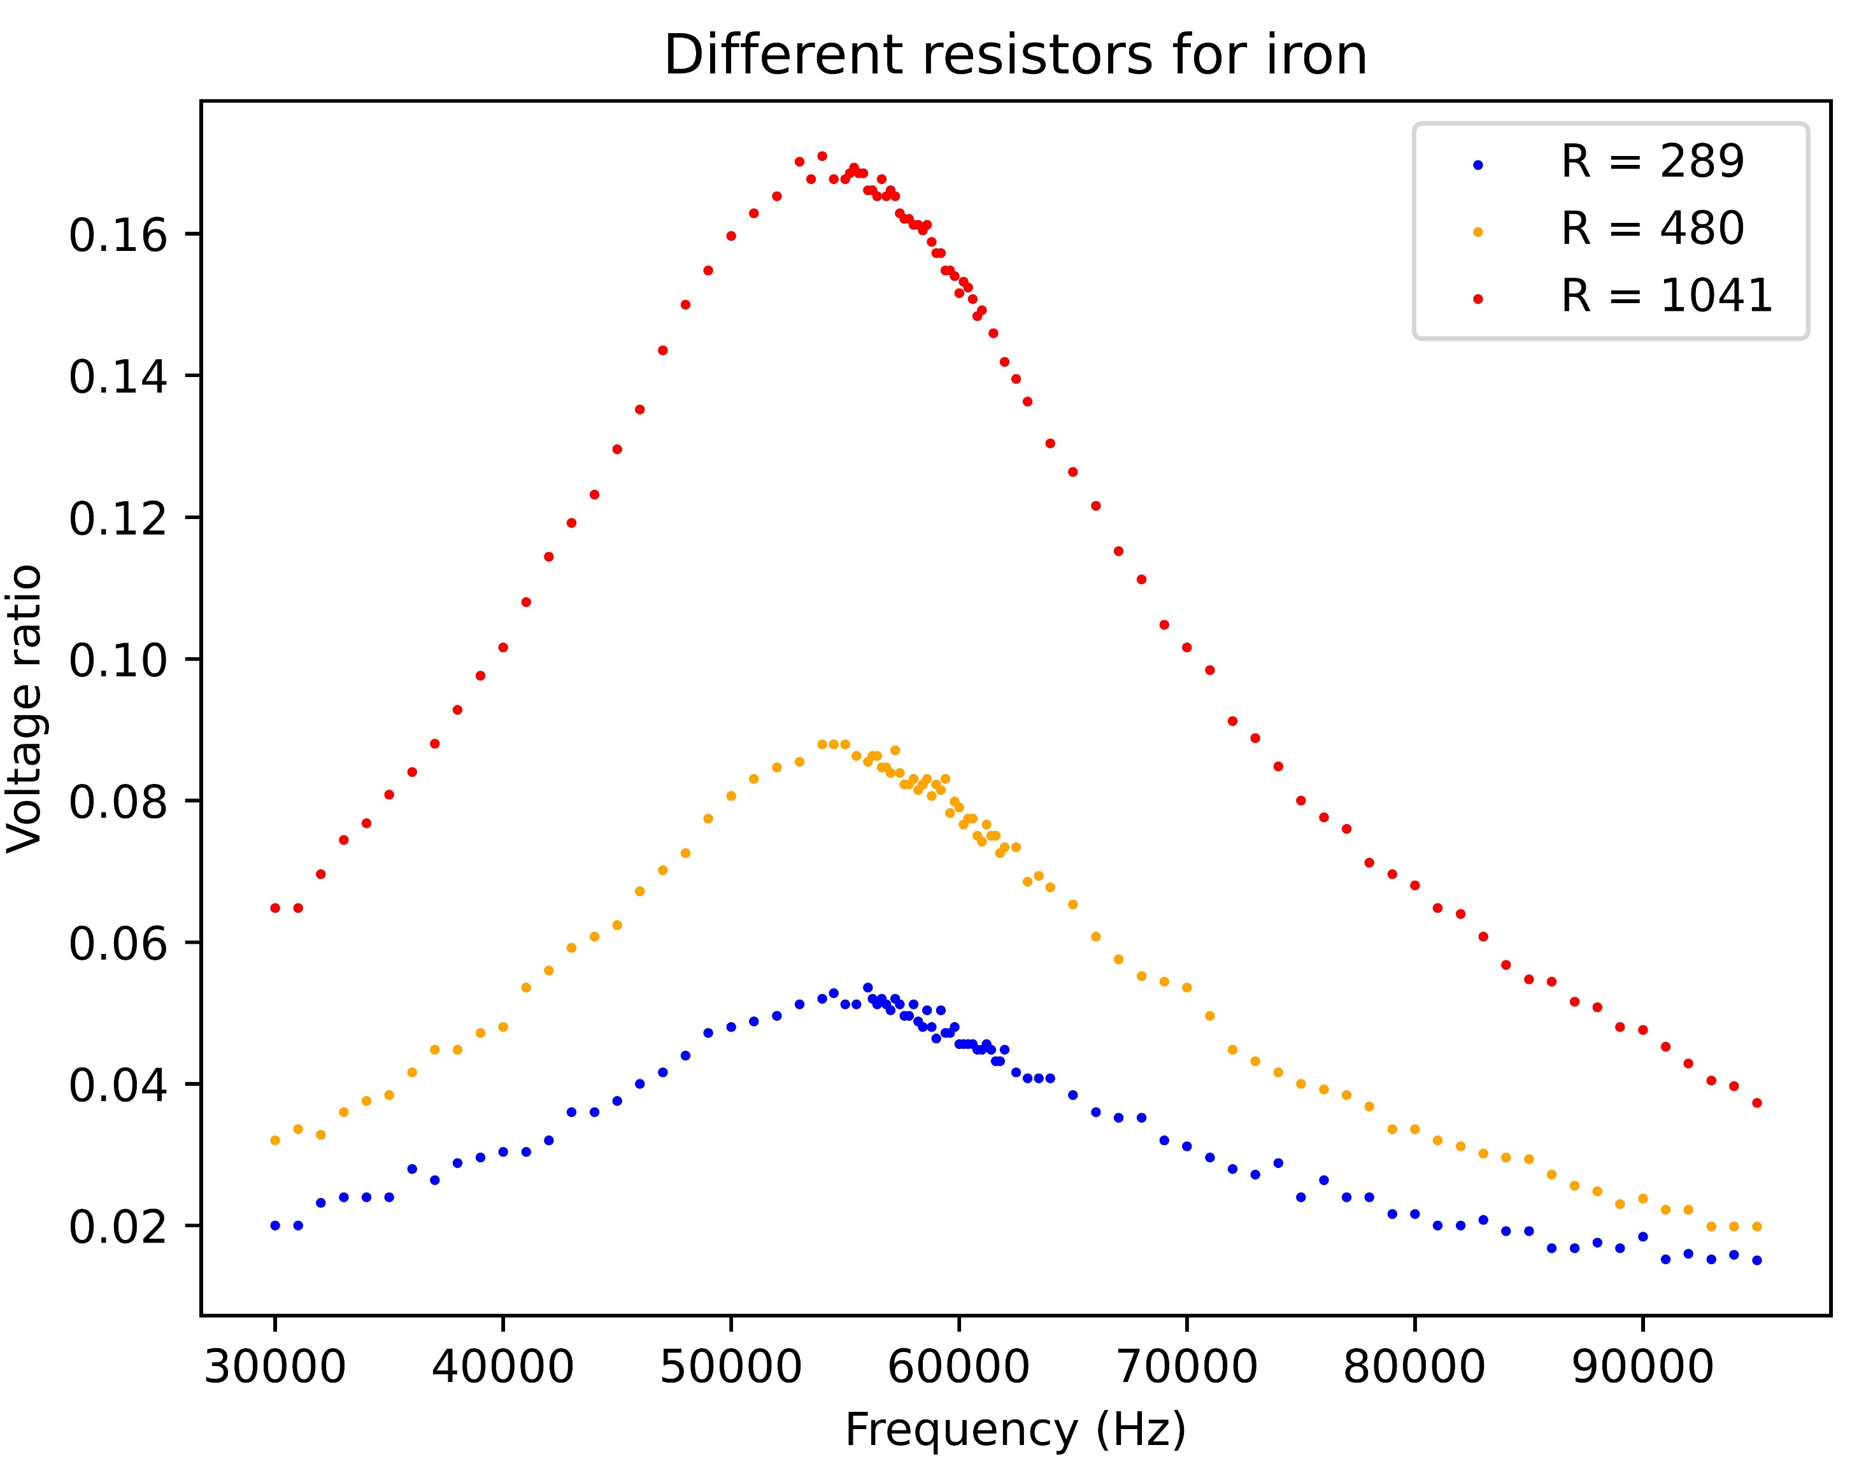
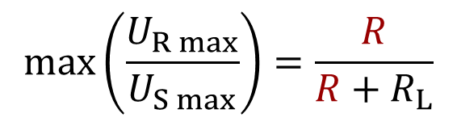
Different resistors
aluminium is similar to copper
small ratio →
R_{L} is greater
Ω
Ω
Ω
Ω
Ω
Ω
Only the height of the peaks changes!
$$max\left(\frac{U_{R max}}{U_{S max}}\right)=\frac{R}{R+R_{L}}$$

Slide 19
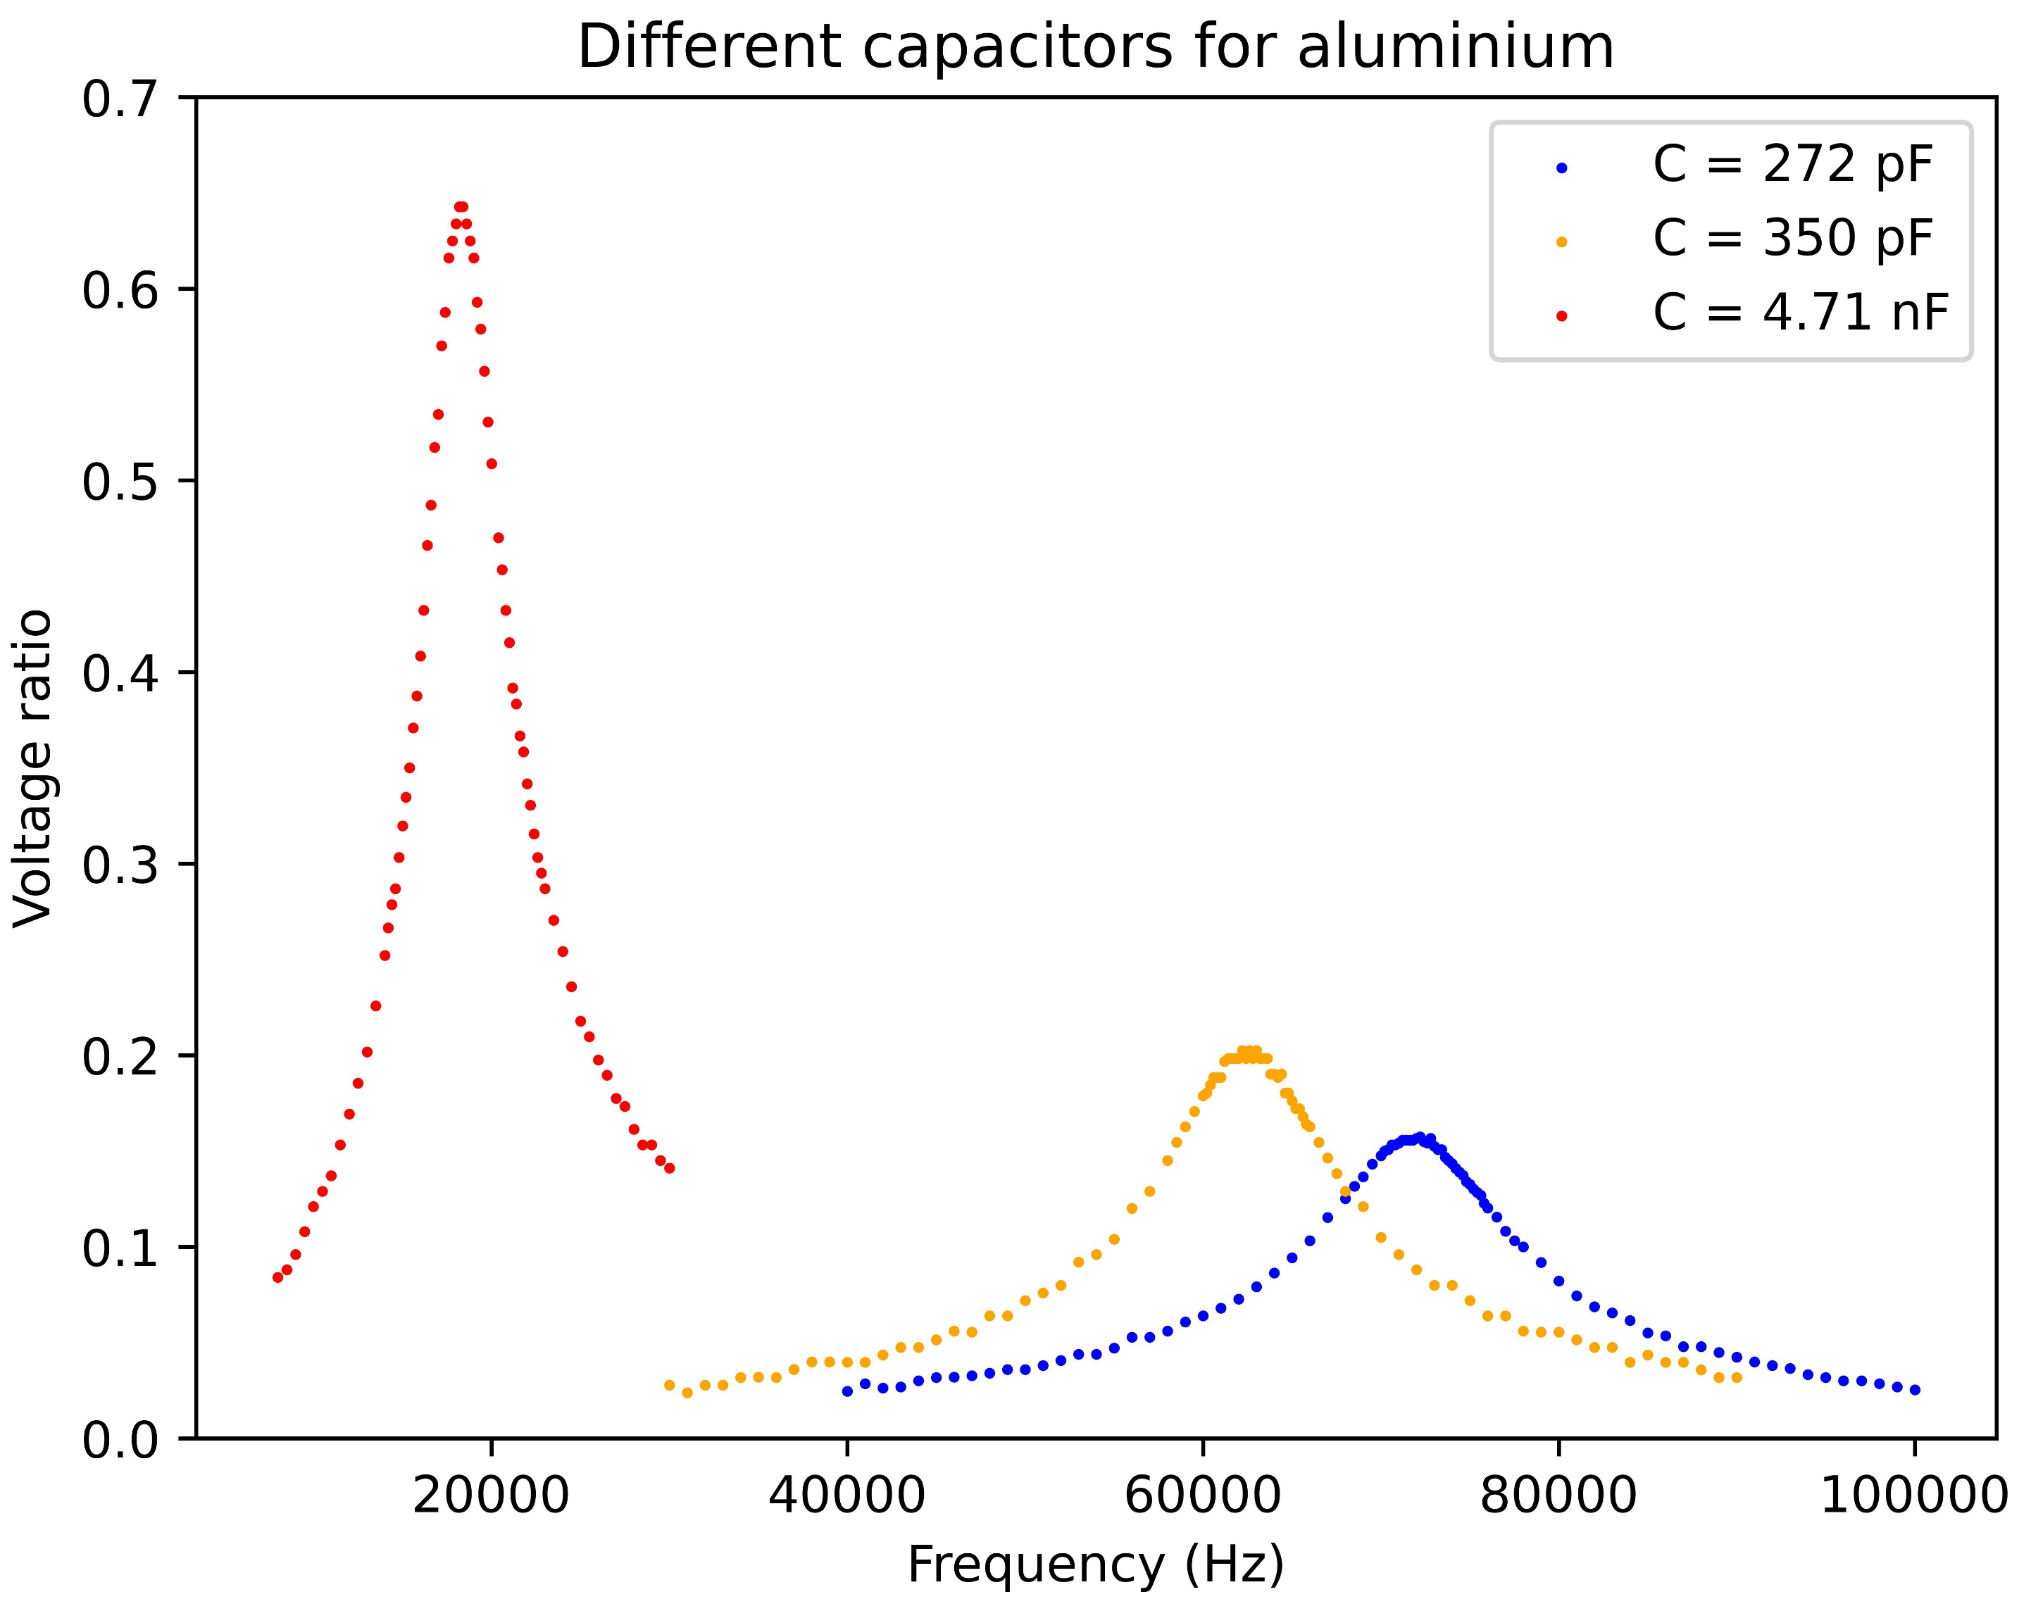
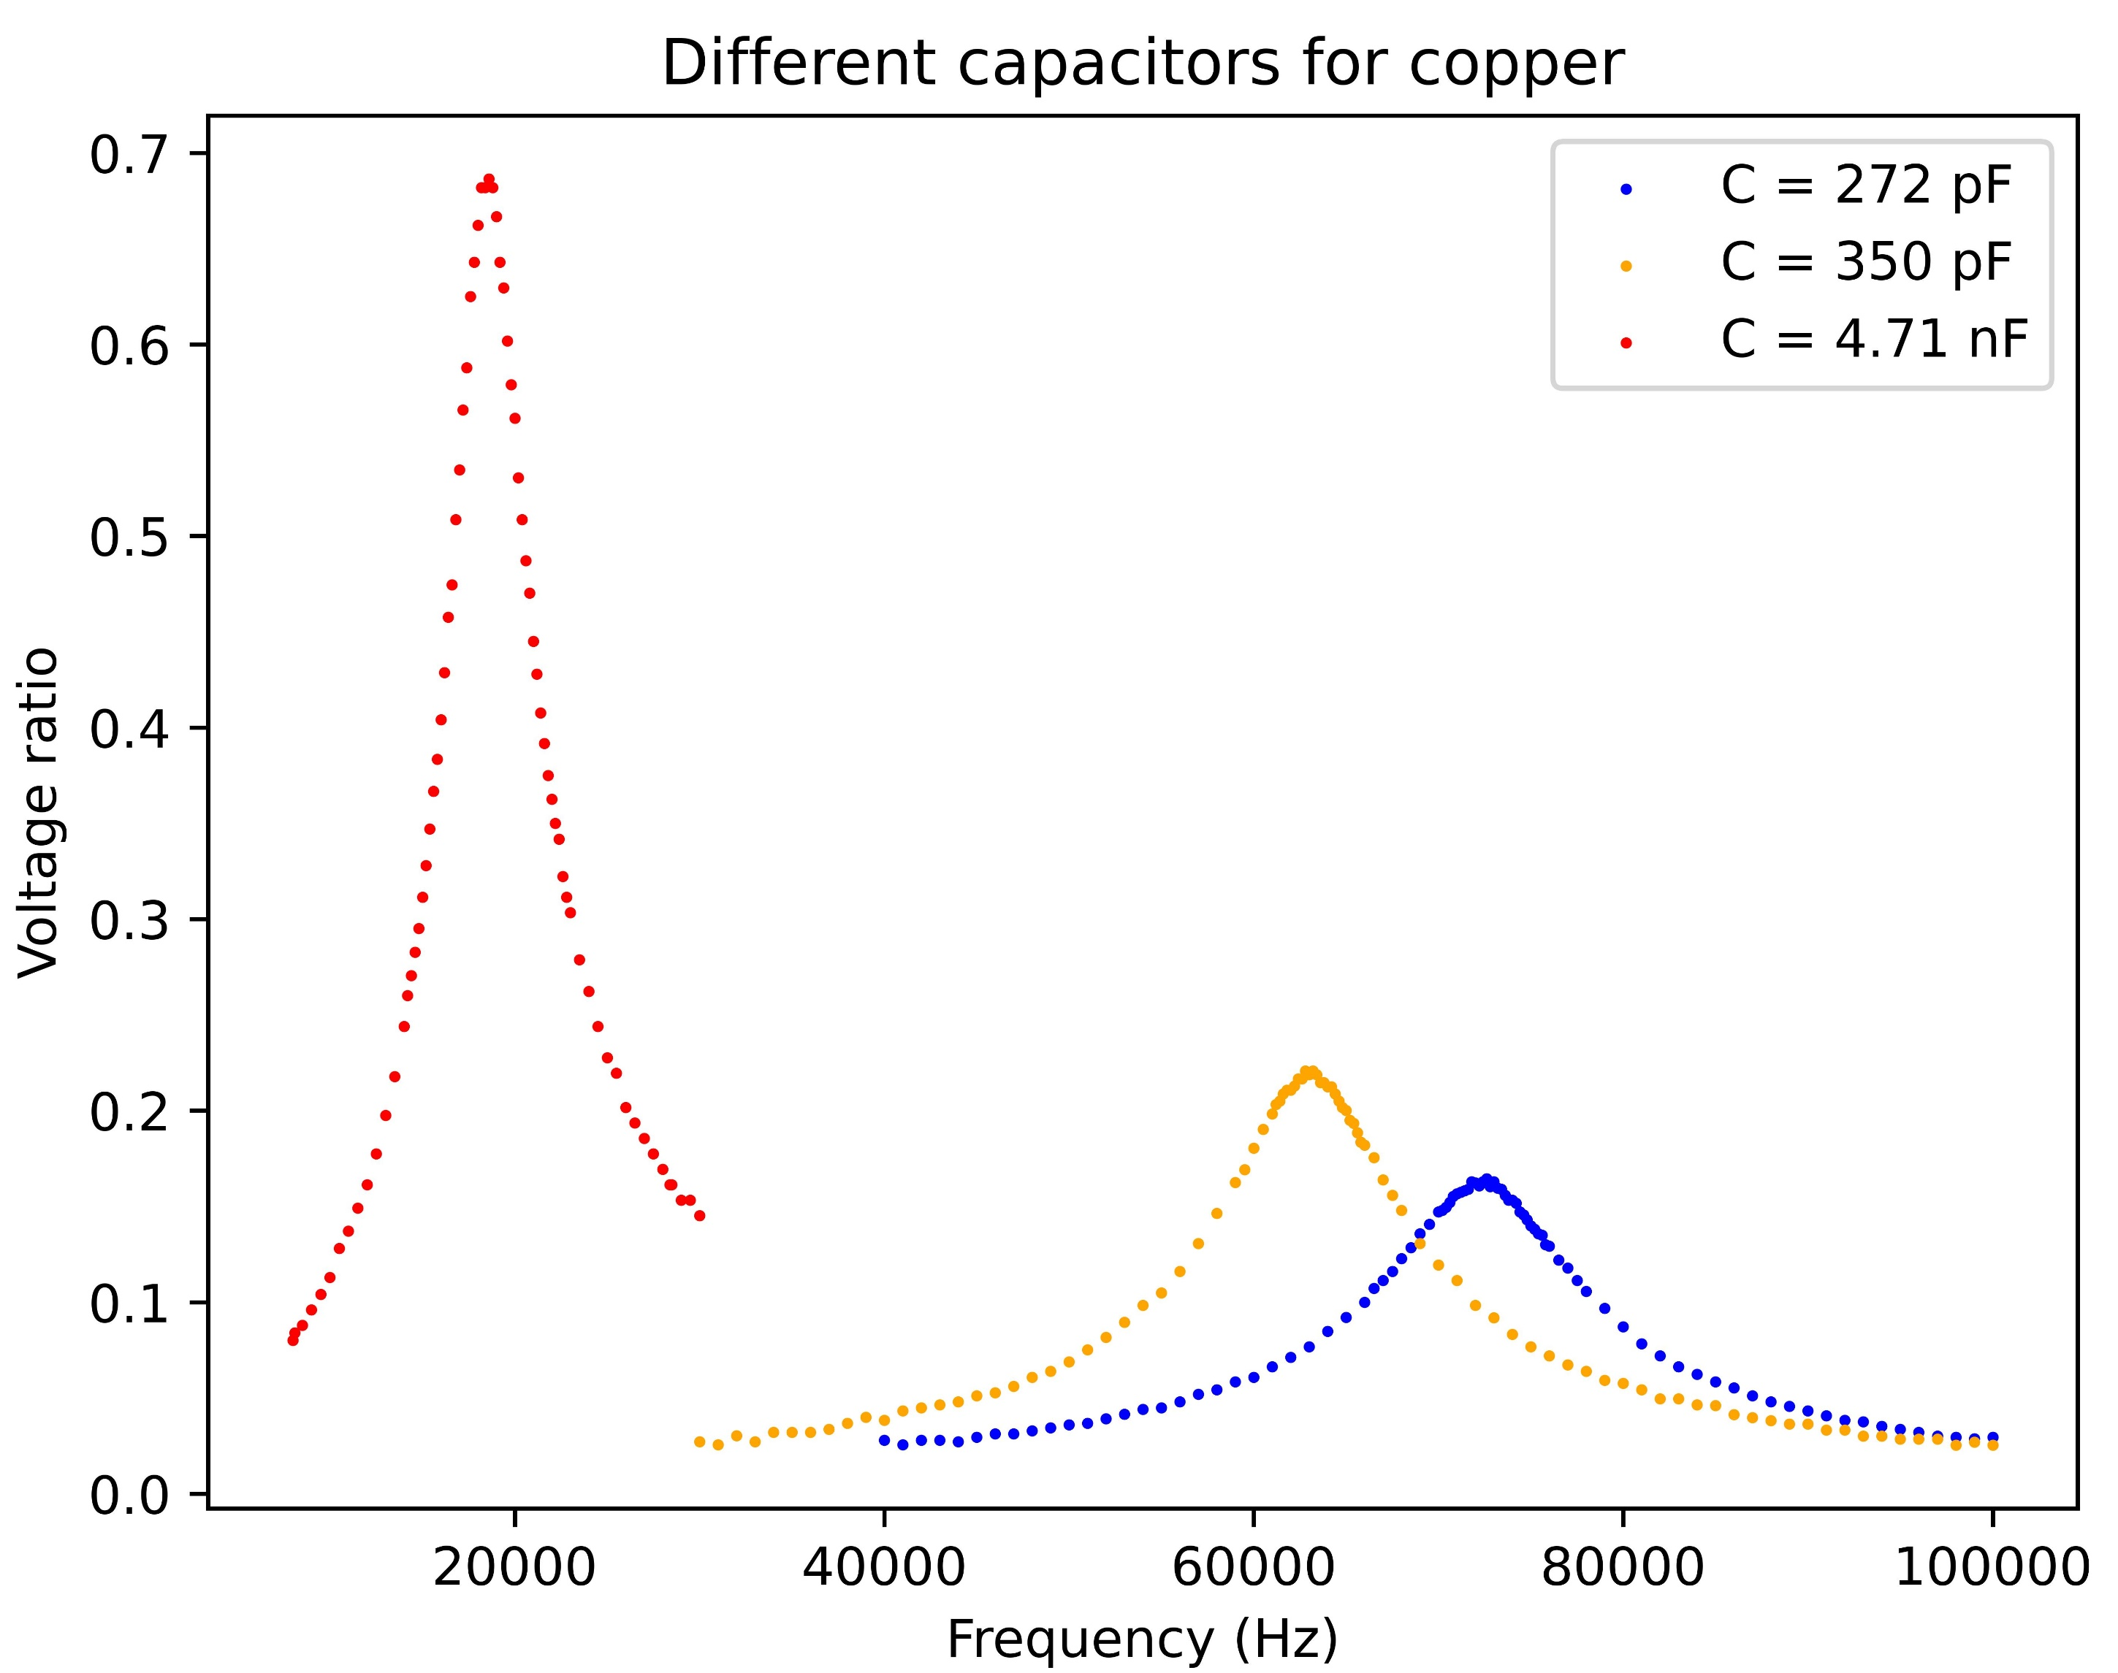
Different capacitors
Resonance frequency changes, but height too!
R_{L} somehow changes
frequency dependent

Slide 20
How do the properties of the core influence L and R_{L}?

Slide 21
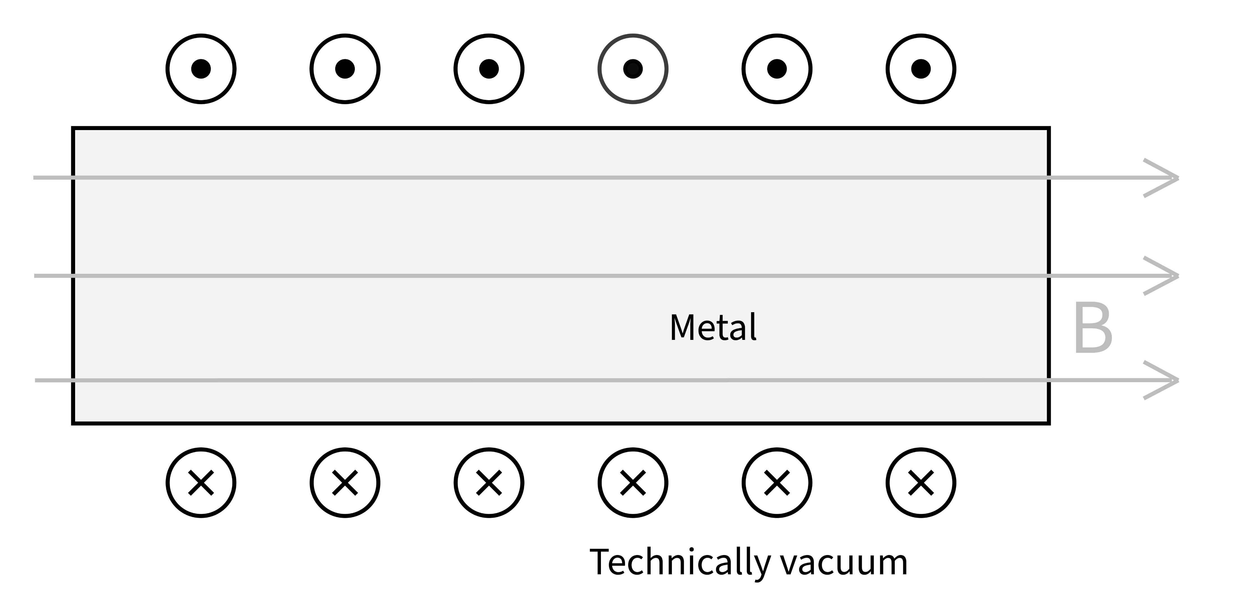
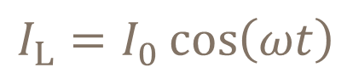
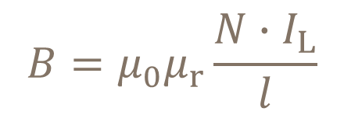
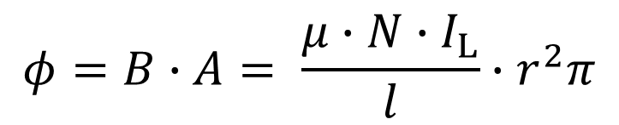
Magnetic field in an ideal coil
(current out)
Magnetic field:
$$B=μ_{0}μ_{r}\frac{N∙I_{L}}{l}$$
Magnetic flux of the coil:
$$φ=B∙A= \frac{μ∙N∙I_{L}}{l}∙r^{2}π$$
(current in)
$$I_{L}=I_{0}\cos\left(ωt\right)$$
magnetic field constantly changes
AC source
μ_{r}: relative permeability of rod , N: number of loops of coil , A: cross-section of rod

Slide 22
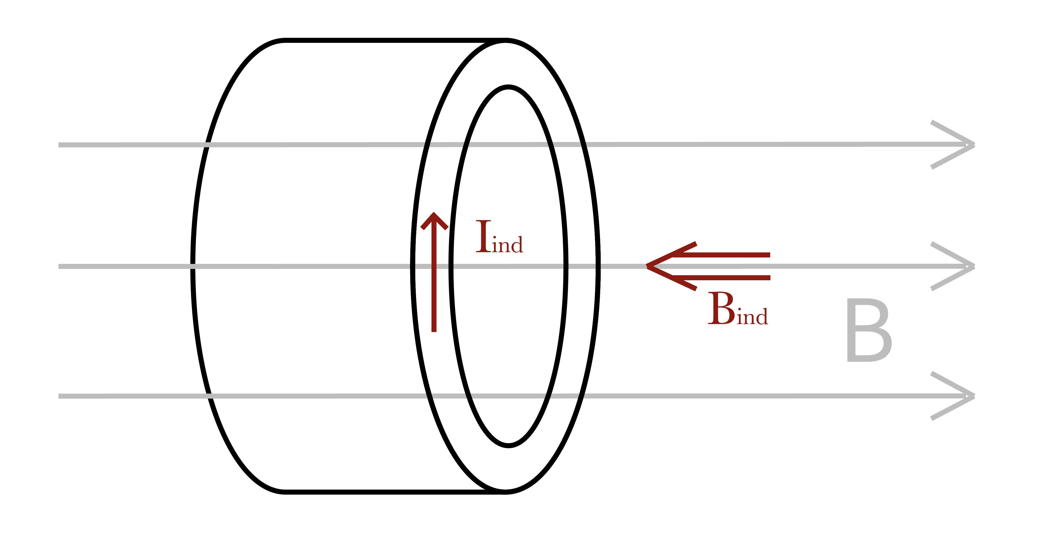
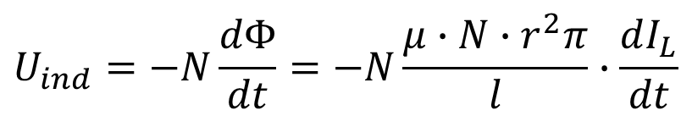
Eddy currents in the core
$$U_{ind}=−N\frac{dΦ}{dt}=−N\frac{μ∙N∙r^{2}π}{l}∙\frac{dI_{L}}{dt}$$
Faraday’s law of induction:
Voltage + closed loop in the core →
Lenz’s law → I_{Eddy} opposes I_{L}
L: inductance of coil
Eddy-currents will flow
Eddy currents induce magnetic fields
concentric currents → B_{ind} grows towards the center
Notes:
… the magnetic field constantly changes. So does the magnetic flux …

Slide 23
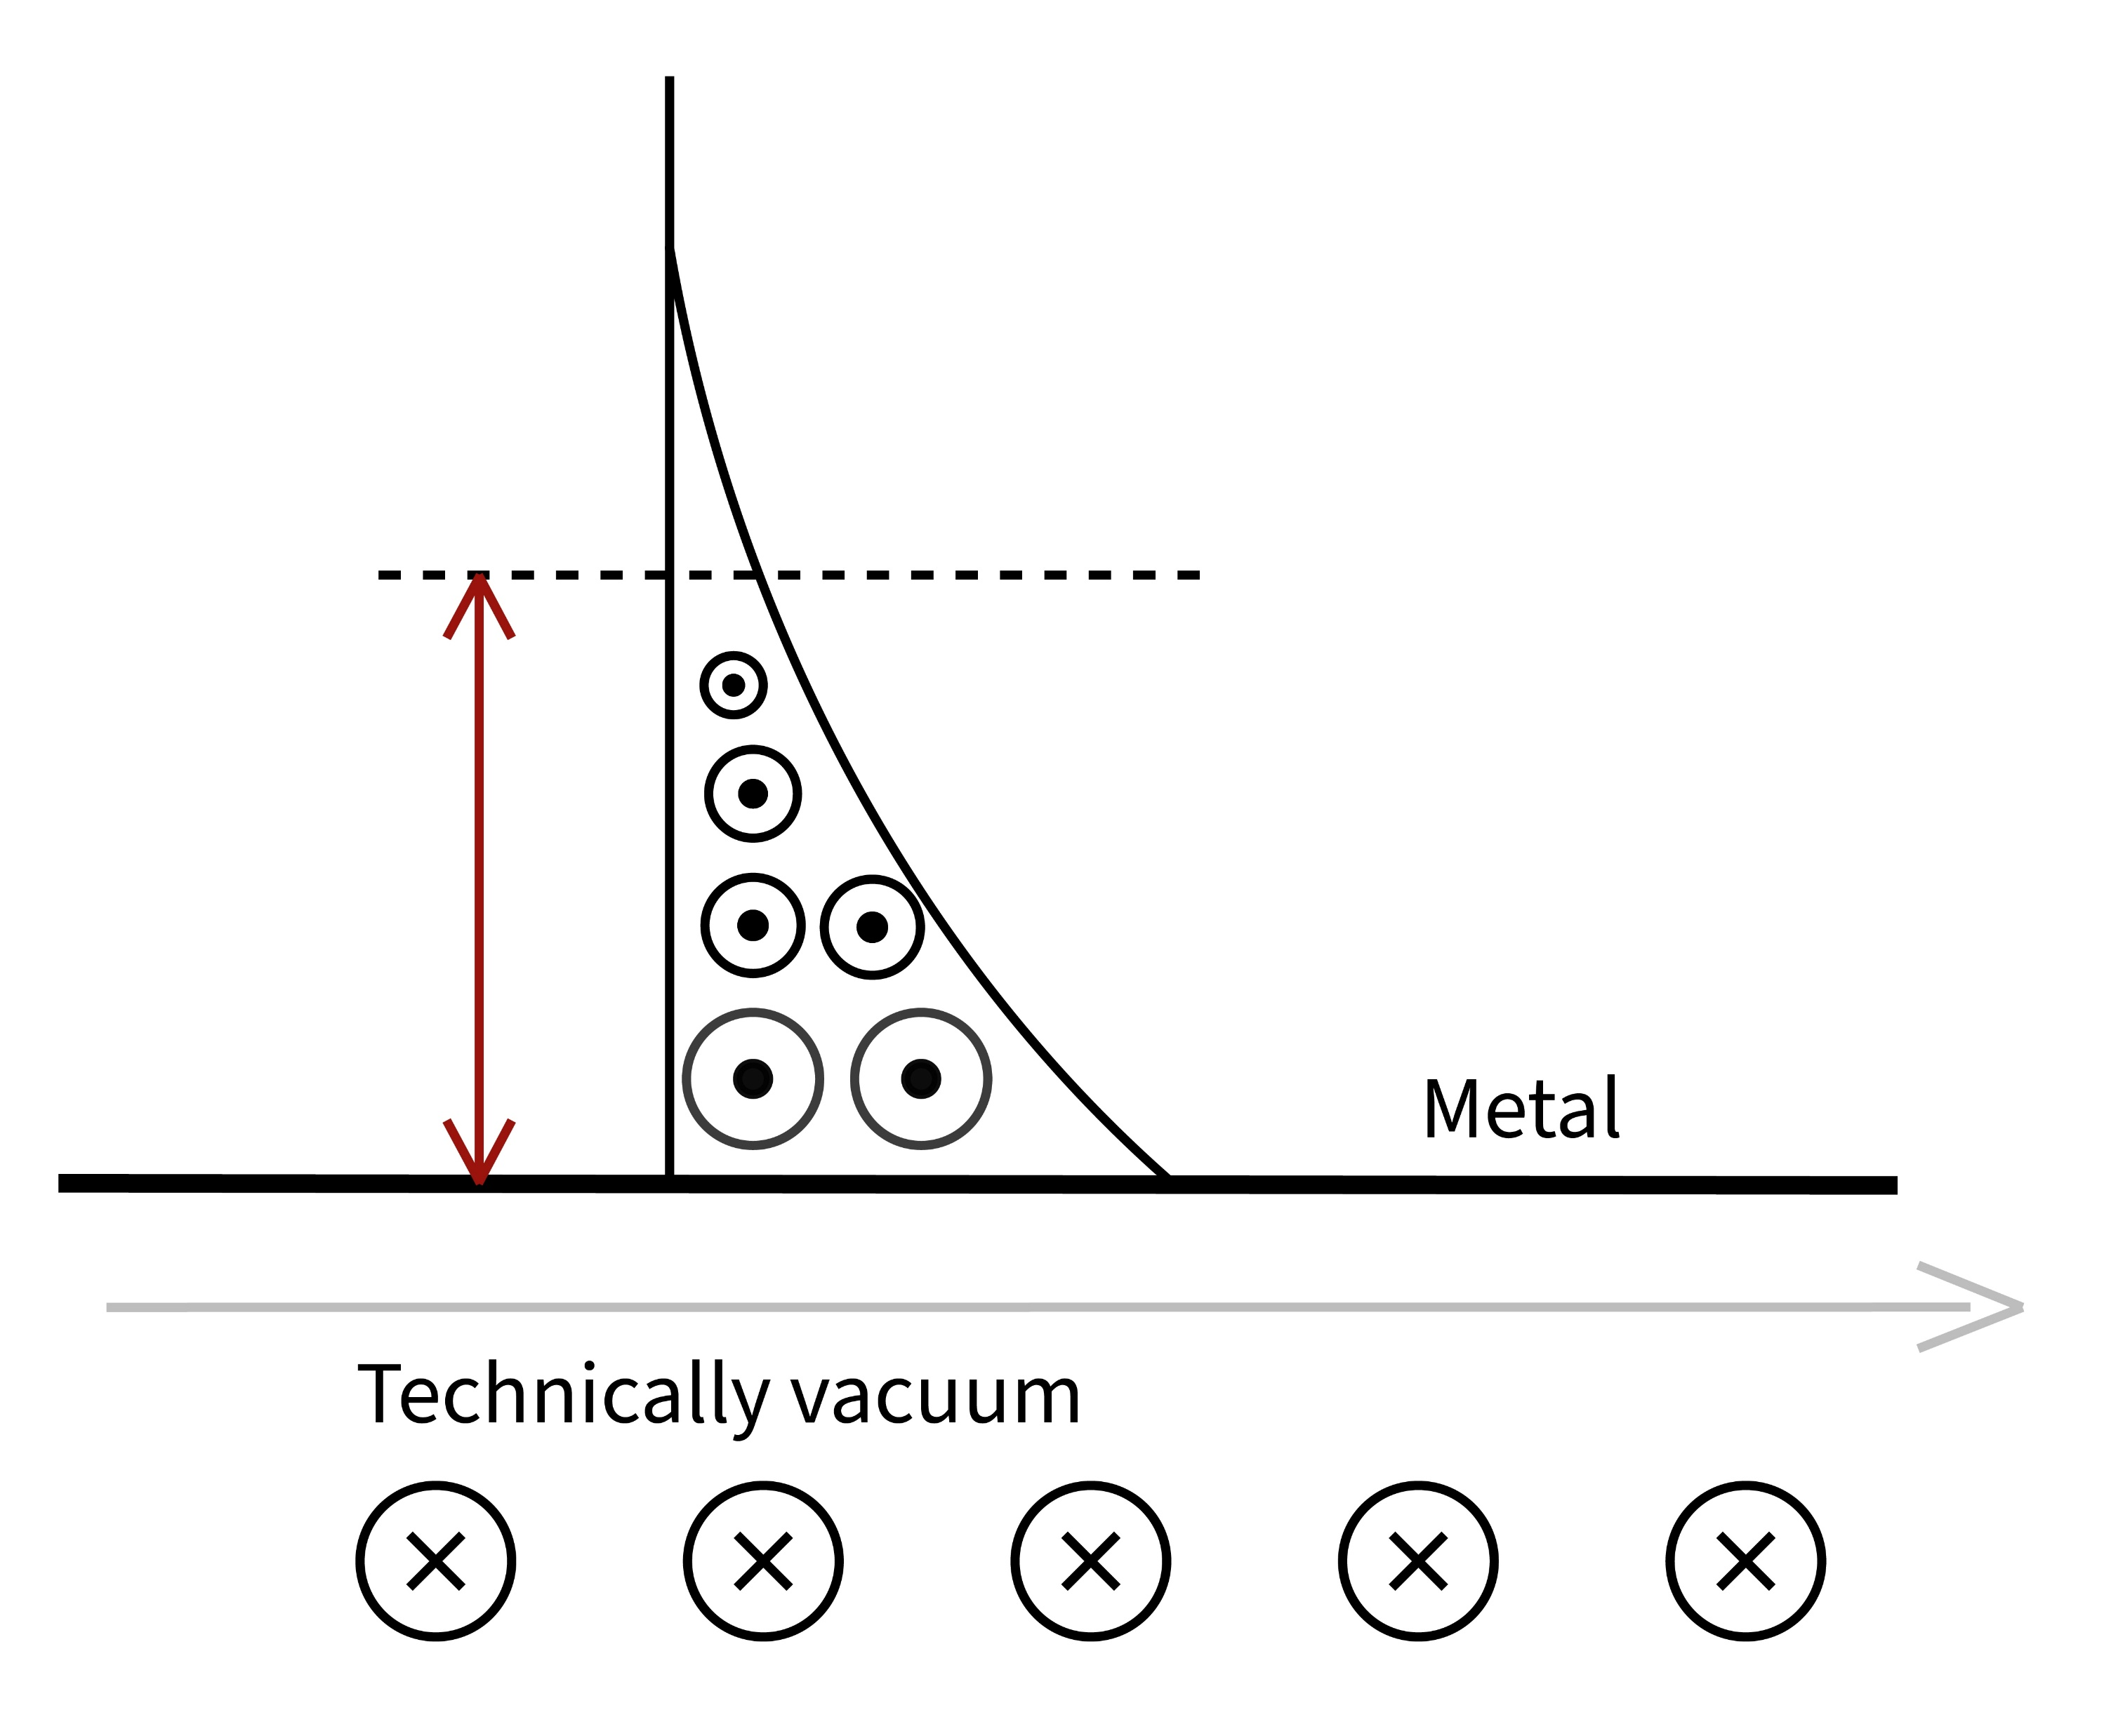
Skin effect
grafikon a különböző B terekről
B_{ind} weakens the original B →
total B exponentially decays – decay rate is the skin depth
magnetic field can only penetrate in the rod until a given distance
Sci-Hub | Formulas for the Skin Effect. Proceedings of the IRE, 30(9), 412–424 | 10.1109/jrproc.1942.232015
opposite Eddy-currents
B = B₀cos(ωt)

Slide 24
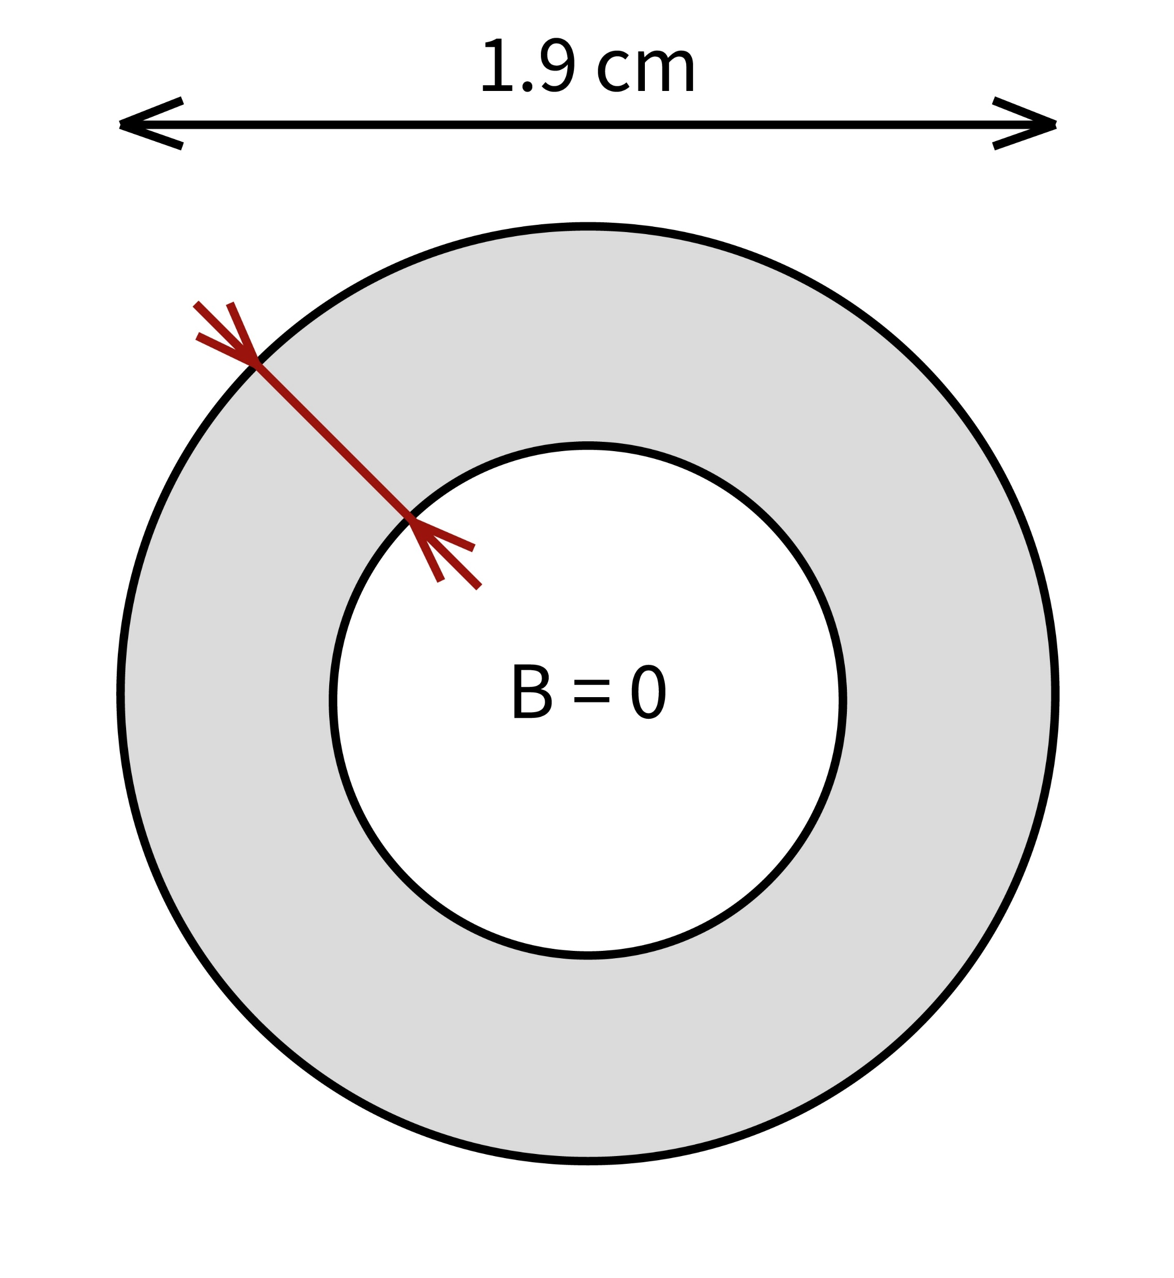





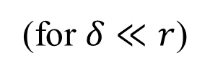
Skin-depth δ
Eq for B decay – delta definition (decay rate)
Fluxus kiintegrálva?
Effective magnetic flux:
$$δ=\sqrt{\frac{2}{ωμσ}}=\sqrt{\frac{2ρ}{ωμ}}$$
$$d=2r$$
δ
(for $δ≪r$)
$$B=0$$
$$Φ_{total}=Φ_{coil+eddy}=B∙A= \frac{μ∙N∙I_{L}}{l}∙(2rπ∙δ)$$
$$B≠0$$
σ: conductivity of rod ; ρ: resistivity of rod
Notes:
EGYENLETEK!!!

Slide 25
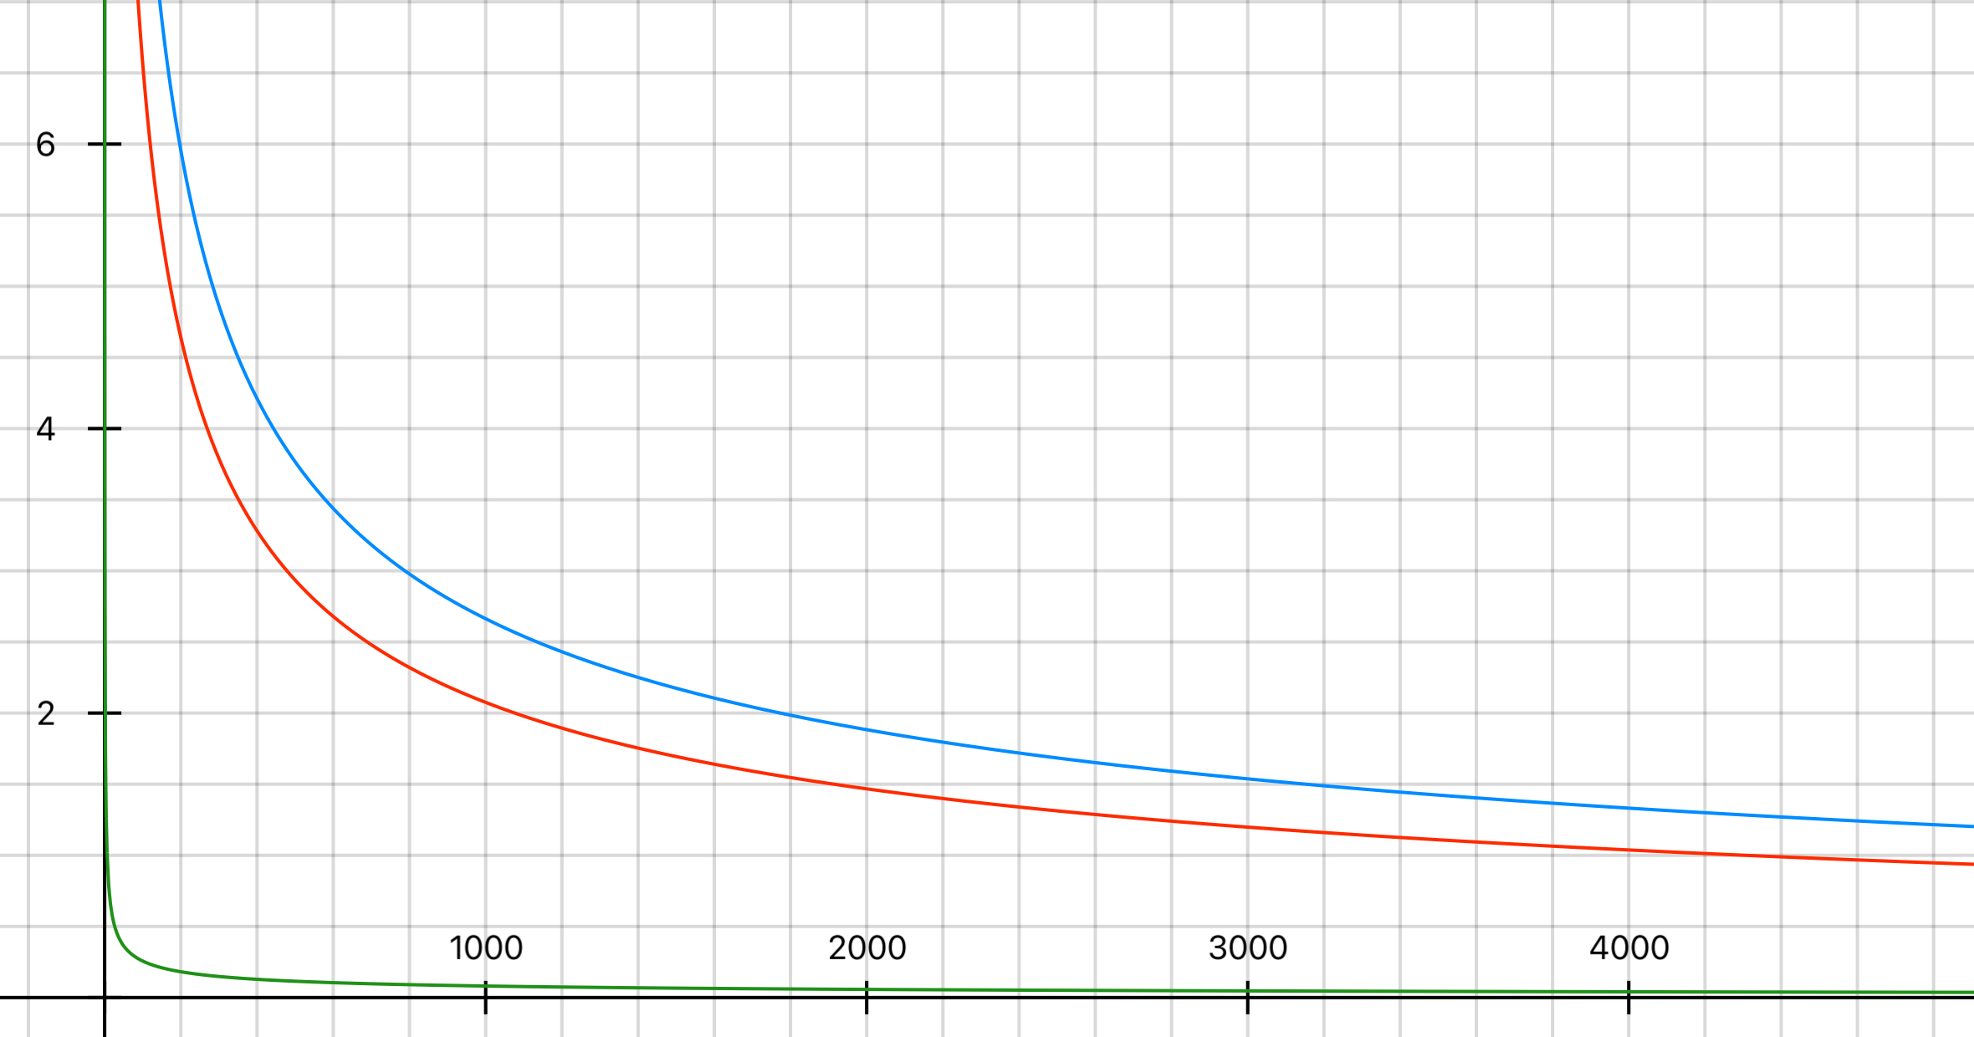
Skin depth (example)
δ (mm)
Measuring range:
8 000 – 100 000 Hz
Aluminium
Copper
Iron
f (Hz)
Notes:
szebb plot – delta eq.val

Slide 26



Experiments – hole in the core
Notes:
új plotok

Slide 27
V. Inductivity and resistance of coil

Slide 28





Inductivity
képek
$$L_{empty}=\frac{μ_{0}N^{2}r^{2}π}{l}$$
$$N\frac{dΦ_{tot}}{dt}=L \frac{dI}{dt}$$
(electromagnetic induction)
$$N∙\frac{μ_{0}μ_{r}NI}{l}∙2rπδ=L∙I$$
$$L=\frac{μ_{0}μ_{r}N^{2}2rπδ }{l}=\frac{μ_{0}μ_{r}N^{2}2rπ\sqrt{\frac{2}{ωμ_{0}μ_{r}σ}}}{l}=\frac{2\sqrt{2}πrN^{2}\sqrt{μ_{0}}}{l\sqrt{ω}}∙\sqrt{\frac{μ_{r}}{σ}}$$
electric and magnetic properties arise:
$$\frac{μ_{r}}{σ} =\frac{l^{2}L^{2}f}{{πμ_{0}d}^{2}N^{4}}$$
The same ratio can be expressed from the change of resistance of the coil – irrelevant.
Notes:
permeability and conductivity can’t be separated

Slide 29




Currents in the core
I_{L}
$$R=ρ\frac{l_{wire}}{A_{wire}}$$
I_{tube}
$$R_{tube}=ρ\frac{2rπ}{δ∙l}$$
$$I_{tube}=N∙I_{L}$$

Slide 30



Heat loss
resistance of the wires is constant (a bedugáskor!) →
Joule-heating in the core:
$${δP}_{core}=I_{tube}^{2}∙R_{tube}=I_{L}^{2}∙∆R_{L}$$
$$ρ\frac{2rπ}{δl}∙{\left(NI_{L}\right)}^{2}=I_{L}^{2}∙∆R_{L}$$
$$∆R_{L}=ρ\frac{2rπN^{2}}{δ∙l}$$
$$R_{tube}=ρ\frac{2rπ}{δ∙l}$$
$$I_{tube}=N∙I_{L}$$
$$∆R_{L}\sim \sqrt{\frac{μ_{r}}{σ}}$$
Notes:
nem az a delta

Slide 31


Electric and magnetic properties
From L:
$$\frac{μ_{r}}{σ} =\frac{l^{2}L^{2}f}{{πμ_{0}d}^{2}N^{4}}=kL^{2}f\sim \frac{1}{f}∗∗3$$
Constant for the coil:
$$k=8,46∙{10}^{−7}$$
From deltaR:
Notes:
A*m / V*s odaírni MÉRTÉKEGYSÉG!!!

Slide 32
VII. Comparison, accuracy

Slide 33

Comparison
literature range
measurements
Notes:
különböző módokat más-más dián?

Slide 34
Accuracy
különböző paramétereknél hogy javul/romlik az eredmény

Slide 35
VII. Summary

Slide 36




Summary
Procedure:
Measure both peak voltages and the phase
Calculate L and R_{L} through curve fitting
Solve the resulting equation system
$${ω_{res}}^{2}\sim \sqrt{\frac{σ}{μ_{r}}}$$
$$\frac{{U_{R}}^{max}}{{U_{T}}^{max}}\sim \sqrt{\frac{σ}{μ_{r}}}$$
$$∆R_{L}=ρ\frac{2rπ∗N^{2}}{δ∗l}$$
$$L=L_{empty}∗\frac{2δ}{r}∗μ_{r}$$

Slide 37






Summary
Thank you for your attention!

Slide 38
Structure
problem statement, basic physics
theory I – RLC circuit
RLC measurement setup
evaluation → L and dR
theory II – Maxwell, obtaining σ and μ
relevant params, prooving skin depth
comparison – limitations
summary – whole process

Slide 39


Appendix – different resistors
Notes:
új plottok, mik változnak, képlettel – beszélni a plotokról! – frekvencia függés bevezetése

Slide 40


Appendix – different capacitors
Notes:
új plottok, mik változnak, képlettel – beszélni a plotokról! – frekvencia függés bevezetése

Slide 41

Appendix – phase angle measurement

Slide 42
Appendix – electric and magnetic properties
Material | Relative permeability | Conductivity (S/m , 20°) | Temperature coefficient
Al | 1,000022 | 3,77 e7 | 3,9 e-3
Cu | 0,999994 | 5,96 e7 | 4,04 e-3
Annealed Cu |  | 5,8 e7 | 3,93 e-3
Fe (98% pure) | 5000 - 200000 | 1,03 e7 | 5 e-3
Steel | 100 - 38000 | 1,45 e6 – 6,99 e6
Sources:
Appendix 8: Electrical Conductivity of Selected Materials - An Introduction to Materials Engineering and Science - Wiley Online Library
Electrical resistivity and conductivity – Wikipedia
Permeability (engineeringtoolbox.com)

Slide 43
Appendix – sources
2560px-Inductor_symbol.svg.png (2560×640) (wikimedia.org)
capacitor-symbol.jpg (600×200) (wiltronics.com.au)
2560px-Resistor_symbol_Europe.svg.png (2560×1280) (wikimedia.org)
360_F_508722395_Pl3TdrRJjGBqpwcFETTLJf3xlWi9D09I.jpg (360×360) (ftcdn.net)
0 (976×385) (mtstatic.com)

Slide 44






LRC circuit components
Driving AC voltage:
Inductor:
resists the change of current
voltage goes in front of current ($φ=90°$)
Resistor:
no phase difference between U and I
Capacitor:
resists the change of voltage
voltage lags behind current ($φ=−90°$)
$$U_{S}=U_{0}\sin\left(ωt\right)$$
$$U_{L}=L\frac{dI_{L}}{dt}=ω∙L∙I_{L}$$
$$X_{L}=ωL$$
$$U_{R}=RI_{R}$$
$$I_{C}=C\frac{dU_{C}}{dt}=ω∙C∙U_{C}$$
$$X_{C}=−\frac{1}{ωC}$$
changes when inserting the rod
Notes:
reactance – resistance-like property

Slide 45





Phasor diagram
Reactance and resistance – phasors
Impedance (vector sum):
φ angle – phase difference between U and I:
$$\left|Z\right|=\sqrt{R^{2}+{\left(X_{L}−X_{C}\right)}^{2}}$$
$$X_{L}=ωL$$
$$X_{C}=\frac{1}{ωC}$$
steady-state response
Notes:
érdekesebb, egyszerűbben érthető legyen, több BASIC physics

Slide 46


Equations – simple LRC theory
$$\frac{U_{R max}}{U_{S max}}=\frac{R}{Z}=\frac{R}{\sqrt{{\left(R+R_{L}\right)}^{2}+{\left(Lω−\frac{1}{Cω}\right)}^{2}}}$$
Ohm’s law
$$φ=arctan⁡\left(\frac{Lω−\frac{1}{Cω}}{R+R_{L}}\right)$$
geometry

Slide 47






Appendix – long rod
72 500 Hz
72 600 Hz
72 400 Hz
The ratio of voltages and resonance frequency should not change!
Notes:
mielőtt kifúrtuk…

Slide 48





Appendix – skin effect illustration

Slide 49
Appendix – proximity effect

Slide 50
Appendix – magnetic hiszterézis

Slide 51

Appendix – ferromagnetism vs. ferrimagnetism
Ferrite:
Relative permeability: 10 – 20000
very low conductivity
Ferrite | Iron Oxide Compound | Britannica
Ferromagnetism – Wikipedia, Ferrimagnetism – Wikipedia – 1948, Louis Néel

Slide 52


Electric and magnetic properties
Material | Resonance frequency [Hz] | L [H]
Al | 72 300 | 0,0178
Cu | 72 500 | 0,0177
Fe | 56 200 | 0,0295
Ratio ($μ_{0}/σ)$
$$1,938∙{10}^{−5}$$
$$1,922∙{10}^{−5}$$
$$4,138∙{10}^{−5}$$
$$\frac{μ_{r}}{σ} =\frac{l^{2}L^{2}f}{{πμ_{0}d}^{2}N^{4}}=kL^{2}f\sim \frac{1}{f}∗∗3$$
Constant for the coil:
$$k=8,46∙{10}^{−7}$$
Notes:
A*m / V*s odaírni MÉRTÉKEGYSÉG!!!

